Slide 1
Framing the American Dream is an initiative of SBCA

Slide 2
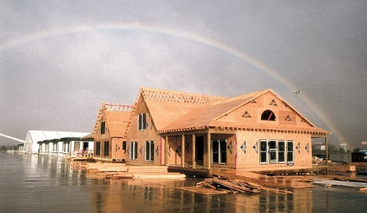
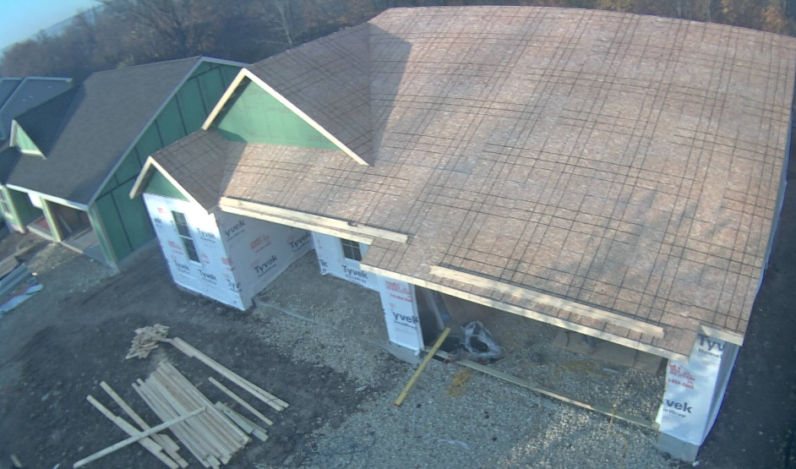
What is the Project?
The Framing the American Dream project set up two controlled experiments:
In each experiment, two identical buildings were framed, providing an apples-to-apples comparison of stick and component framing methods.
One in 1995 in the parking lot of the Houston Astro Arena adjacent to the Houston Astrodome
Another in 2015 in a neighborhood in Jackson, Wisconsin.
Framing the American Dream is an initiative of SBCA

Slide 3
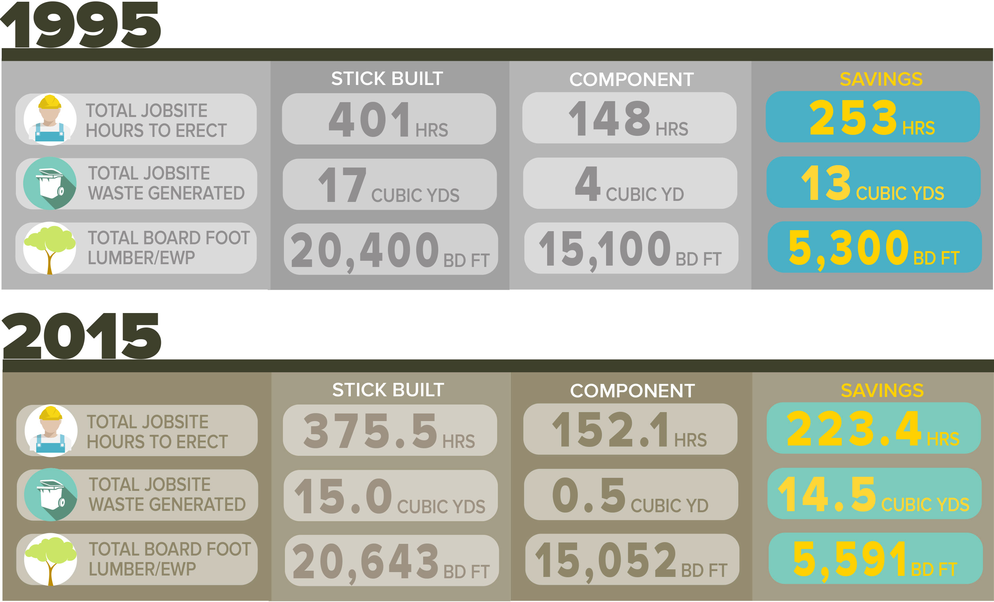
What Did We Learn?
Framing the American Dream is an initiative of SBCA

Slide 4
What Did We Learn?
Framing the American Dream is an initiative of SBCA

Slide 5
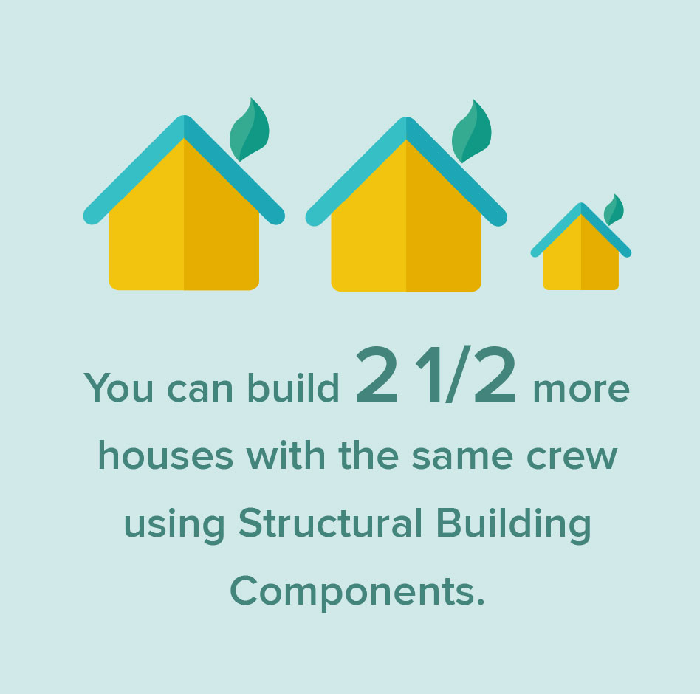
What Did We Learn?
The Framing the American Dream study shows that a crew can frame two and half homes with structural building components in the time it takes to stick-frame one house.
Framing the American Dream is an initiative of SBCA

Slide 6
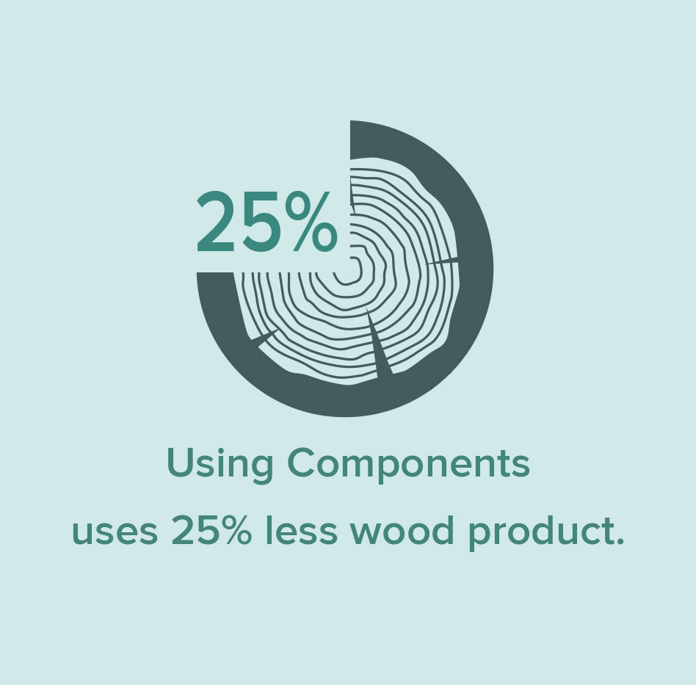
What Did We Learn?
The Framing the American Dream study shows that it takes 25% less wood product to frame a structure using components.
Framing the American Dream is an initiative of SBCA

Slide 7
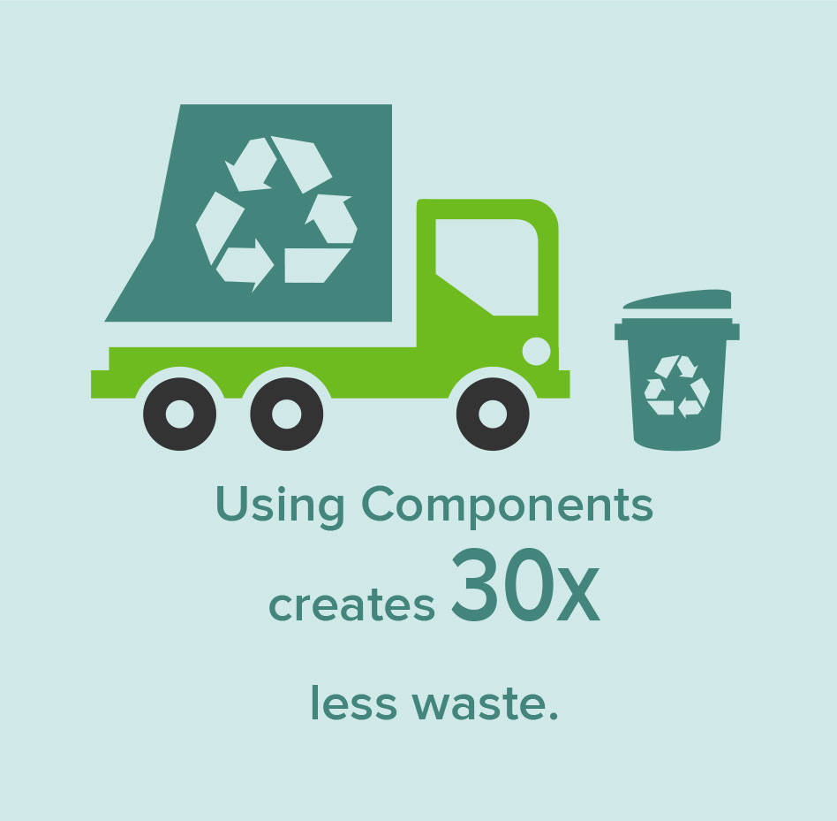
What Did We Learn?
The Framing the American Dream study shows that a stick-framed house creates nearly 30 times more jobsite waste than a component-framed house.
Framing the American Dream is an initiative of SBCA

Slide 8
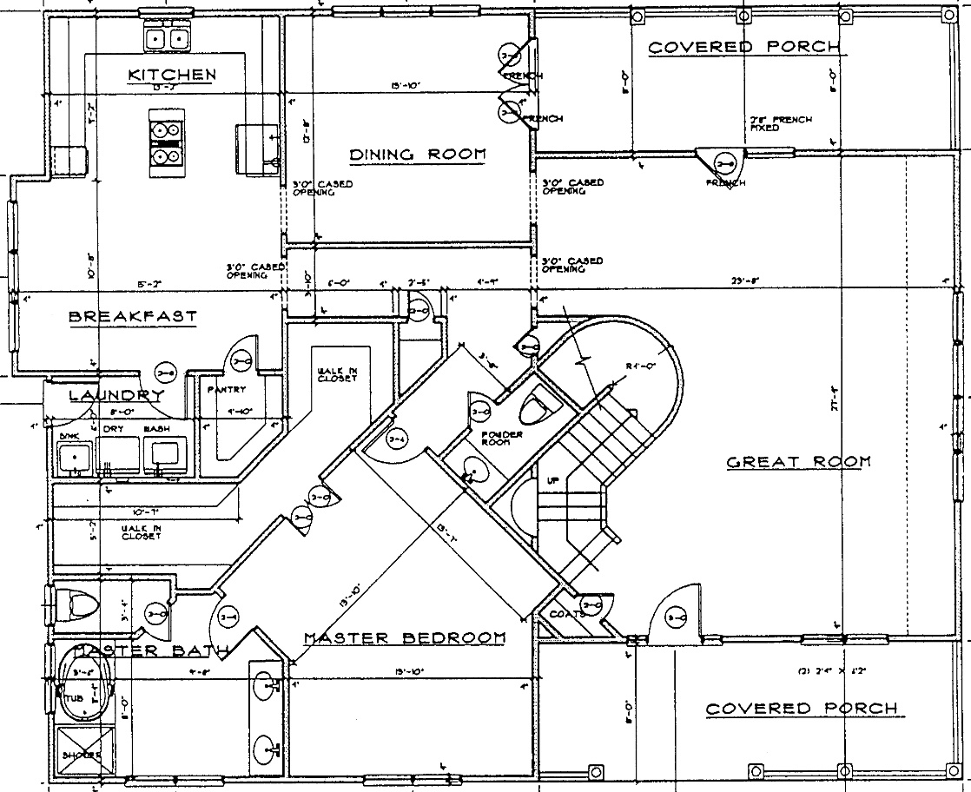
What is the Project?
The Framing the American Dream study set up a controlled experiment to allow for apples-to-apples comparisons.
In 1995, an average 2600 square foot, two-story floorplan was chosen and two identical houses were built side-by-side.
Framing the American Dream is an initiative of SBCA

Slide 9
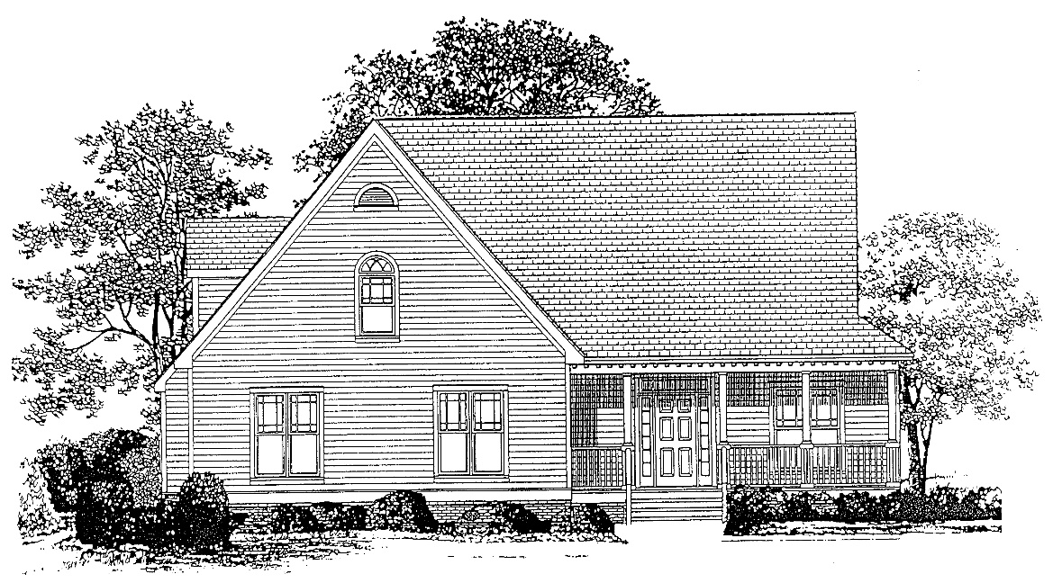
What is the Project?
The Framing the American Dream study set up a controlled experiment to allow for apples-to-apples comparisons.
In 1995, an average 2600 square foot, two-story floorplan was chosen, and two identical houses were built side-by-side.
Framing the American Dream is an initiative of SBCA

Slide 10
What Did We Do?
In 2015, an average 2900 square foot ranch-style floorplan with a walk-out basement was chosen and two identical houses were constructed on adjacent lots.
Framing the American Dream is an initiative of SBCA

Slide 11
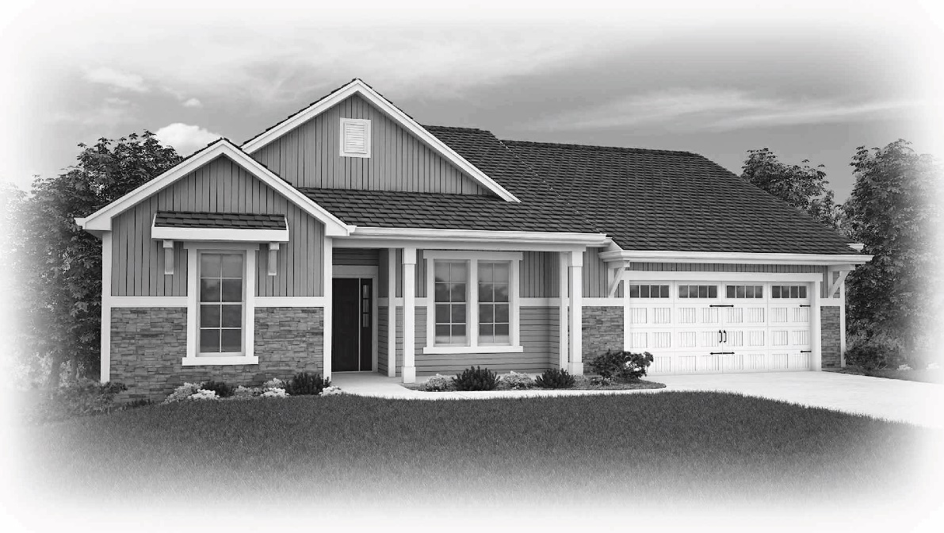
What Did We Do?
In 2015, an average 2900 square foot ranch-style floorplan with a walk-out basement was chosen and two identical houses were constructed on adjacent lots.
Framing the American Dream is an initiative of SBCA

Slide 12
What Did We Do?
The only difference: one house was constructed entirely using conventional stick-framing. The other house was constructed using floor panels, wall panels and roof trusses manufactured in a production facility.
Framing the American Dream is an initiative of SBCA

Slide 13
What Did We Do?
In 1995, photos were taken from the roof of the Astro Arena and observers recorded worker tasks by hand.
In 2015, wireless cameras were put up to monitor and record images from both jobsites.
Framing the American Dream is an initiative of SBCA

Slide 14
Wall Labor Comparison
Framing the American Dream is an initiative of SBCA

Slide 15
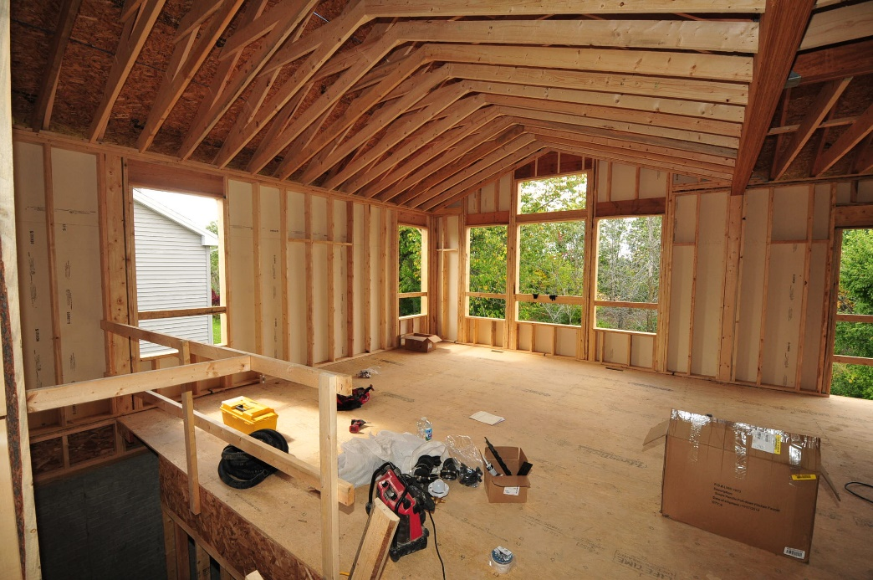
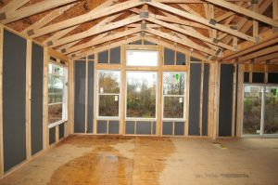
Wall Framing Comparison
Framing the American Dream is an initiative of SBCA

Slide 16
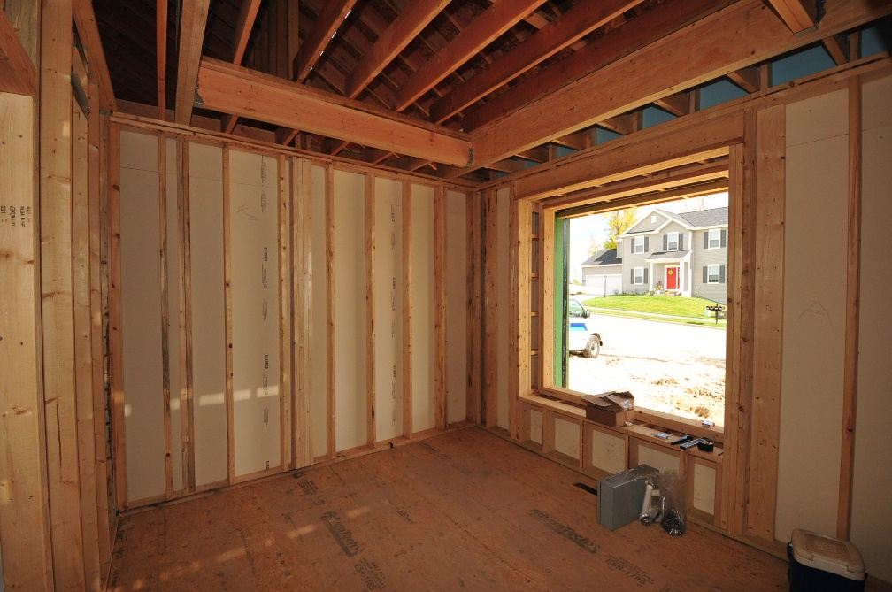
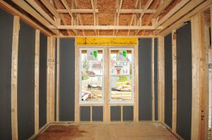
Wall Framing Comparison
Framing the American Dream is an initiative of SBCA

