Slide 1
Framing the American Dream is an initiative of SBCA

Slide 2
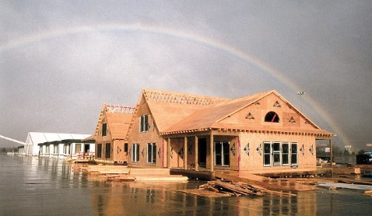
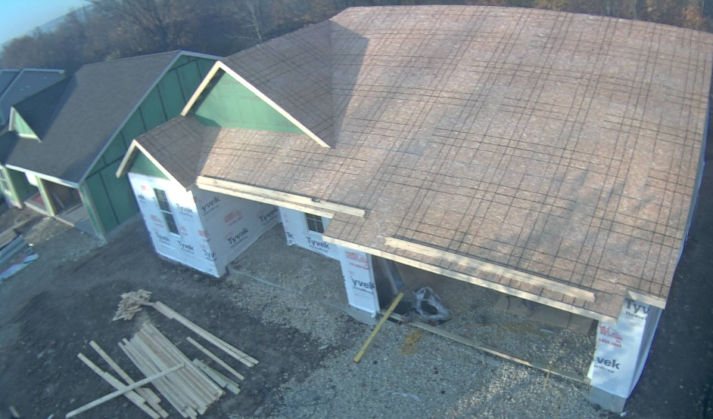
What is the Project?
The Framing the American Dream project set up two controlled experiments:
In each experiment, two identical buildings were framed, providing an apples-to-apples comparison of stick and component framing methods.
  One in 1995 in the parking lot of the Houston Astro Arena adjacent to the Houston Astrodome
  Another in 2015 in a neighborhood in Jackson, Wisconsin.
Framing the American Dream is an initiative of SBCA

Slide 3
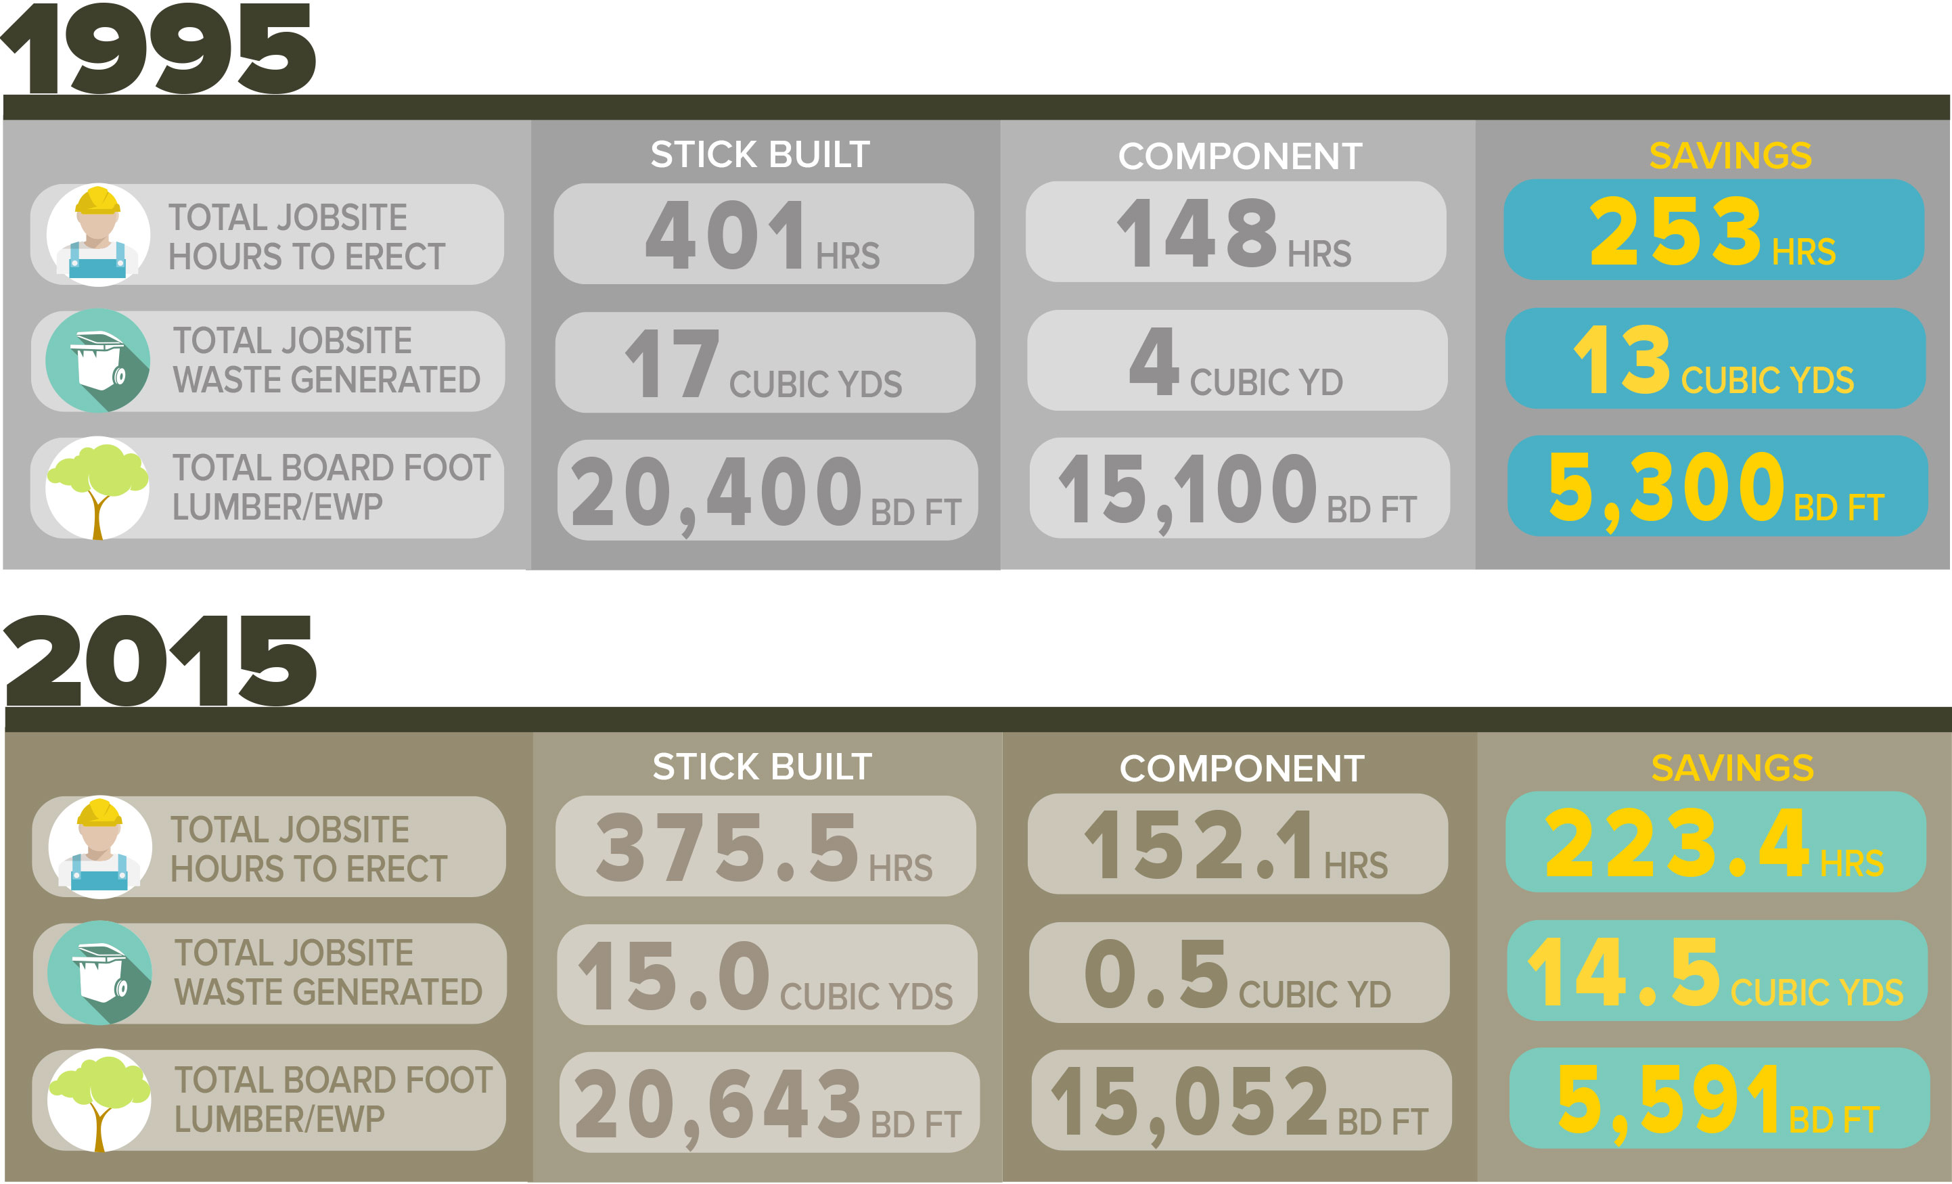
What Did We Learn?
Framing the American Dream is an initiative of SBCA

Slide 4
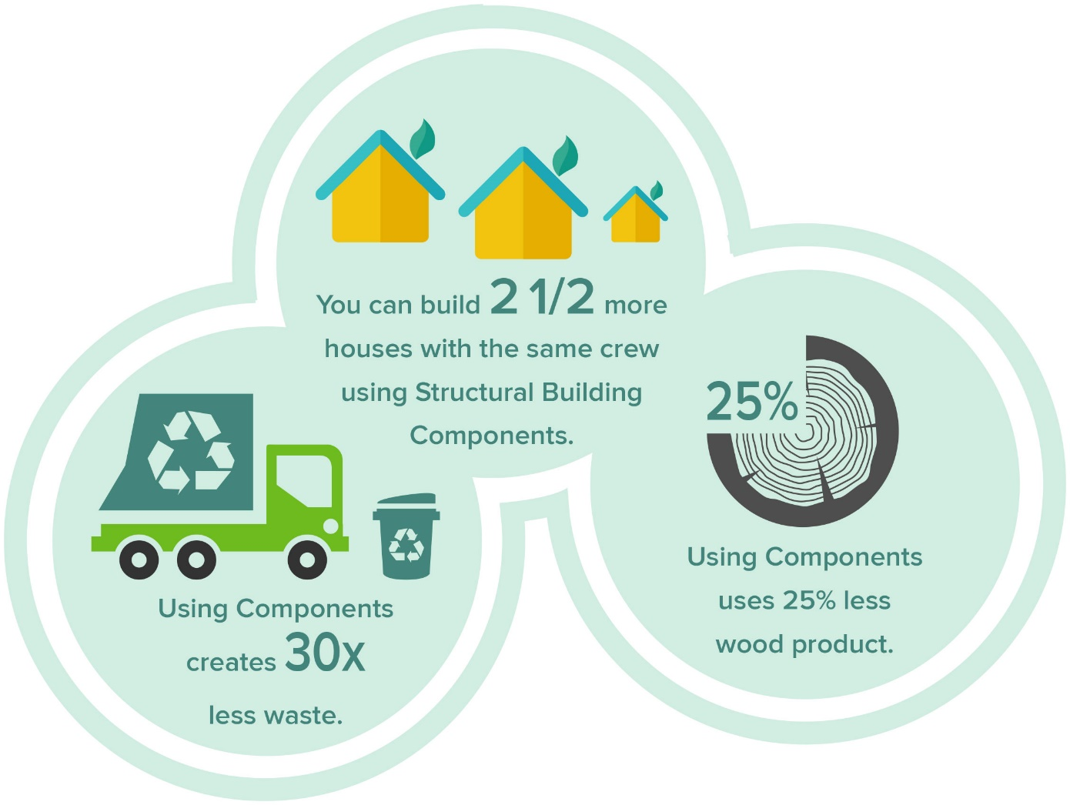
What Did We Learn?
Framing the American Dream is an initiative of SBCA

Slide 5
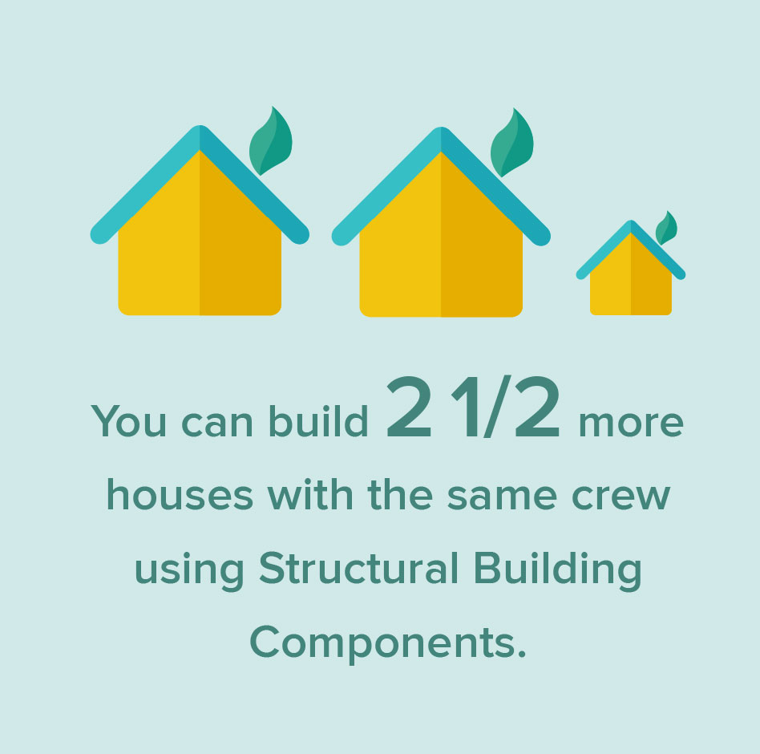
What Did We Learn?
The Framing the American Dream study shows that a crew can frame two and half homes with structural building components in the time it takes to stick-frame one house.
Framing the American Dream is an initiative of SBCA

Slide 6
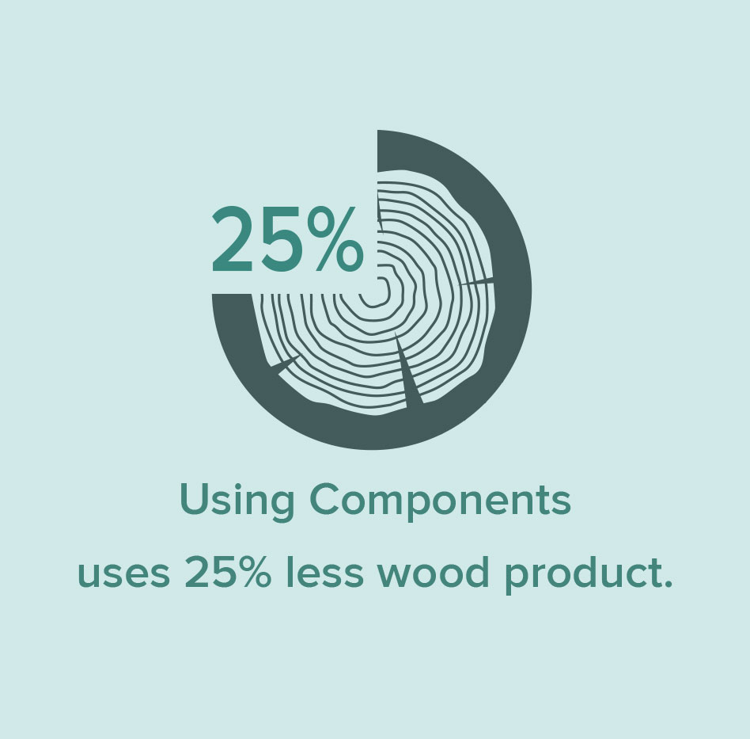
What Did We Learn?
The Framing the American Dream study shows that it takes 25% less wood product to frame a structure using components.
Framing the American Dream is an initiative of SBCA

Slide 7
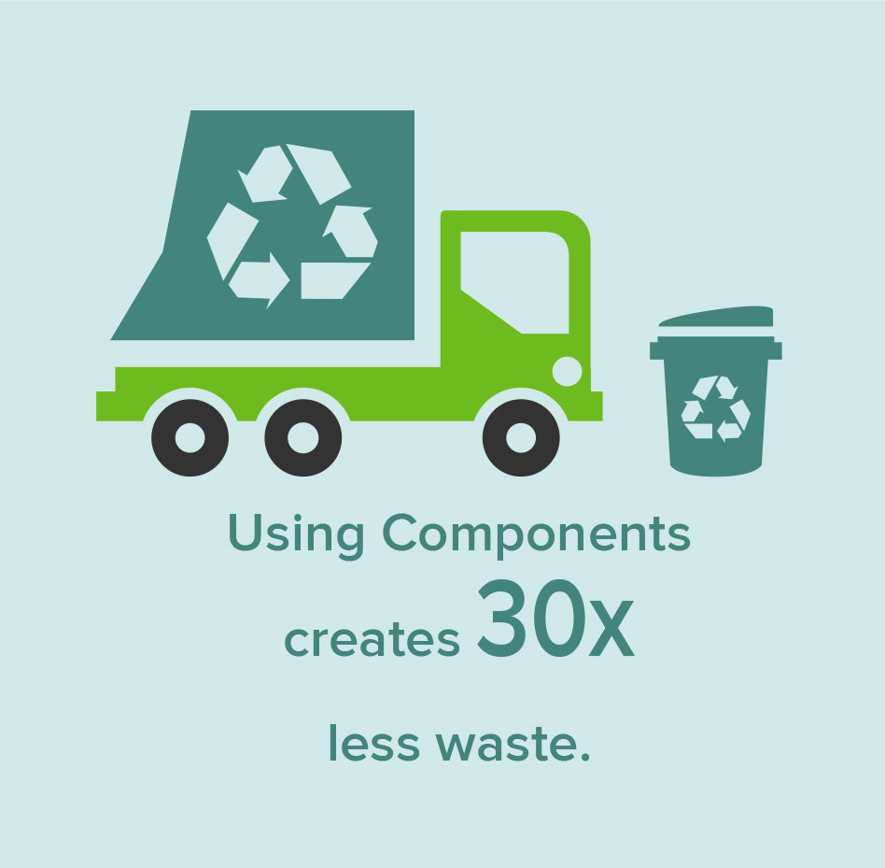
What Did We Learn?
The Framing the American Dream study shows that a stick-framed house creates nearly 30 times more jobsite waste than a component-framed house.
Framing the American Dream is an initiative of SBCA

Slide 8
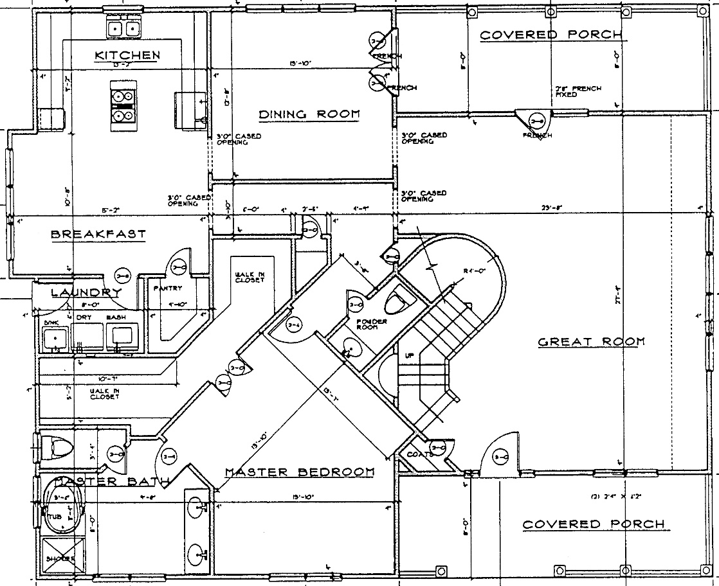
What is the Project?
The Framing the American Dream study set up a controlled experiment to allow for apples-to-apples comparisons.
In 1995, an average 2600 square foot, two-story floorplan was chosen and two identical houses were built side-by-side.
Framing the American Dream is an initiative of SBCA

Slide 9
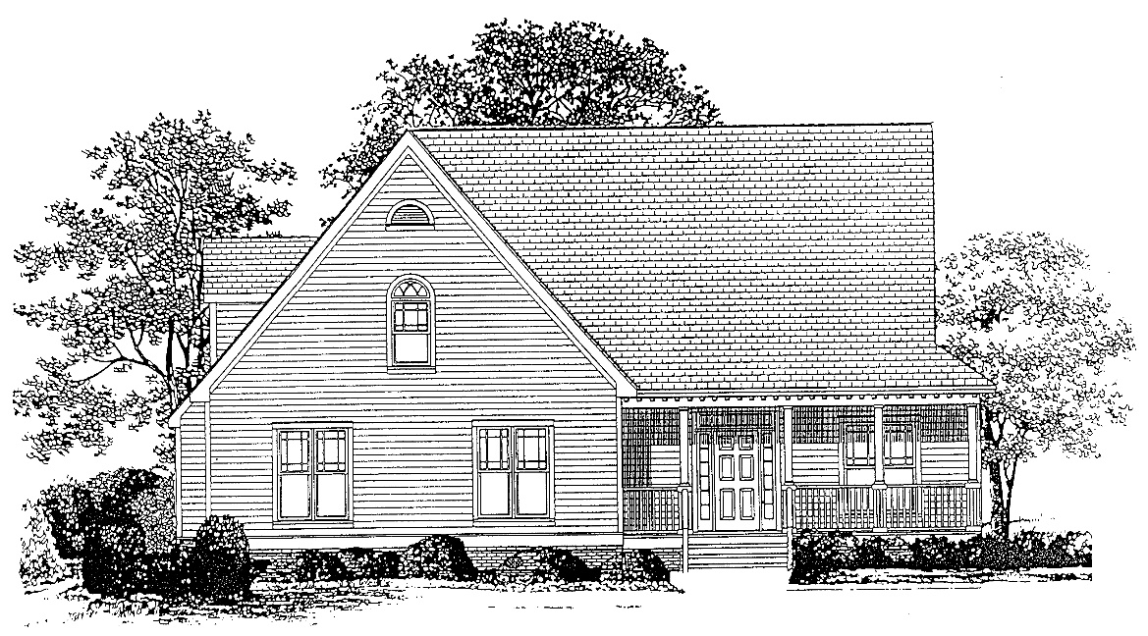
What is the Project?
The Framing the American Dream study set up a controlled experiment to allow for apples-to-apples comparisons.
In 1995, an average 2600 square foot, two-story floorplan was chosen, and two identical houses were built side-by-side.
Framing the American Dream is an initiative of SBCA

Slide 10
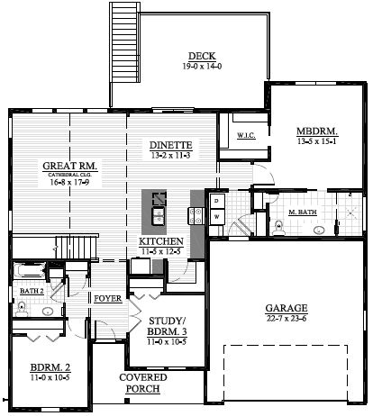
What Did We Do?
In 2015, an average 2900 square foot ranch-style floorplan with a walk-out basement was chosen and two identical houses were constructed on adjacent lots.
Framing the American Dream is an initiative of SBCA

Slide 11
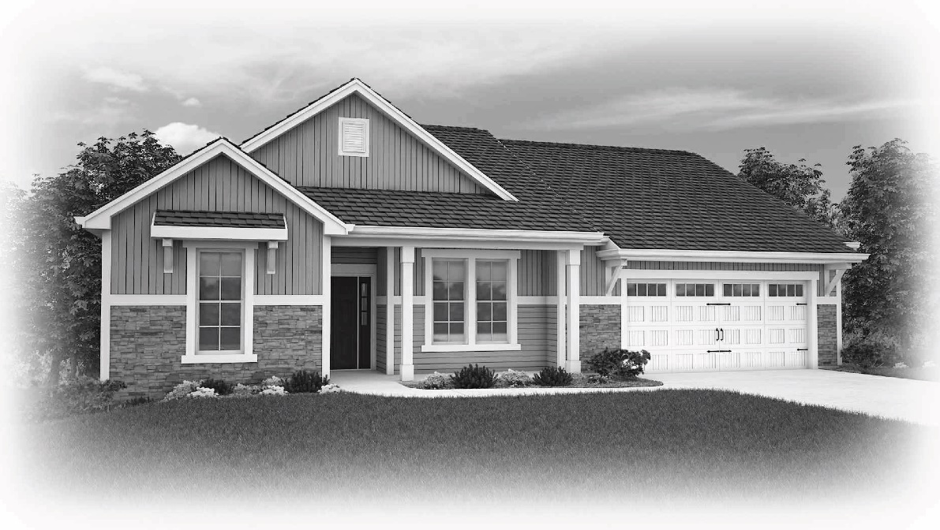
What Did We Do?
In 2015, an average 2900 square foot ranch-style floorplan with a walk-out basement was chosen and two identical houses were constructed on adjacent lots.
Framing the American Dream is an initiative of SBCA

Slide 12
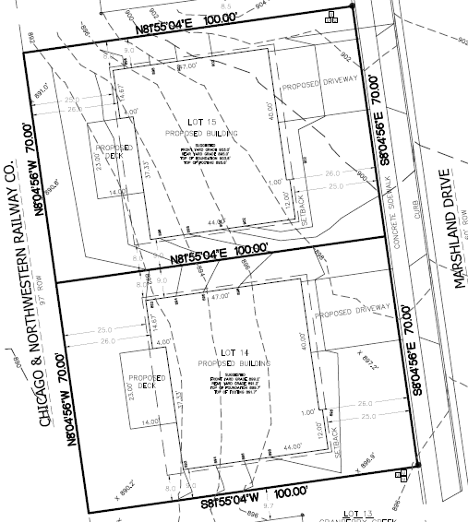
What Did We Do?
The only difference: one house was constructed entirely using conventional stick-framing. The other house was constructed using floor panels, wall panels and roof trusses manufactured in a production facility.
Framing the American Dream is an initiative of SBCA

Slide 13
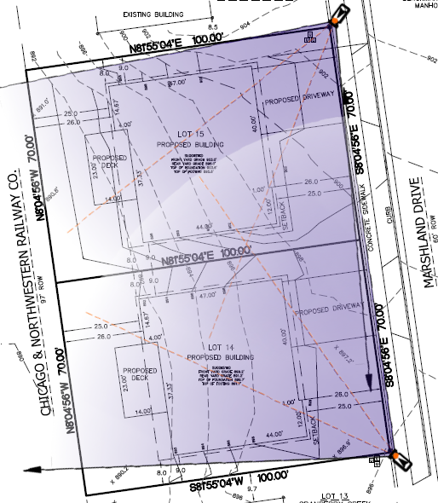
What Did We Do?
In 1995, photos were taken from the roof of the Astro Arena and observers recorded worker tasks by hand.
In 2015, wireless cameras were put up to monitor and record images from both jobsites.
Framing the American Dream is an initiative of SBCA

Slide 14
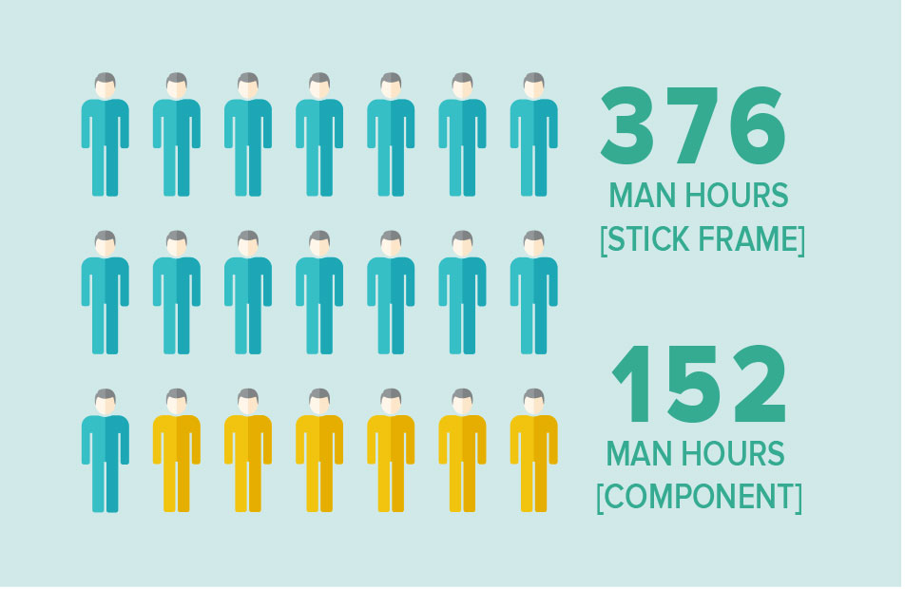
What About Labor?
The results of the Framing the American Dream study looked closely at the total number of hours, broken into discreet framing tasks, to determine how long it took a framing crew to complete each home:
The stick-framed house required 375.5 hours to complete.
Framing the American Dream is an initiative of SBCA

Slide 15
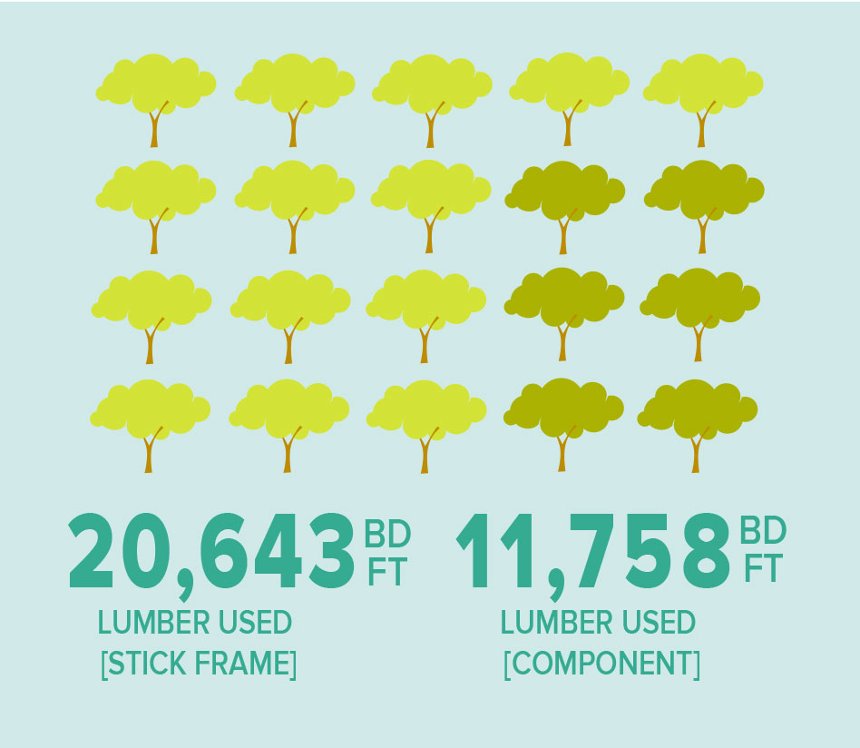
What About Material Use?
The Framing the American Dream study shows a clear difference in material efficiency between the two framing methods.
The stick-framed house used 20,643 board feet of lumber and EWP
Framing the American Dream is an initiative of SBCA

Slide 16
What About Material Use?
The Framing the American Dream study shows a clear difference in material efficiency between the two framing methods.
The stick-framed house used 20,643 board feet of lumber and EWP
This is nearly 25% more wood product than what was used in the component-framed house.
Framing the American Dream is an initiative of SBCA

Slide 17
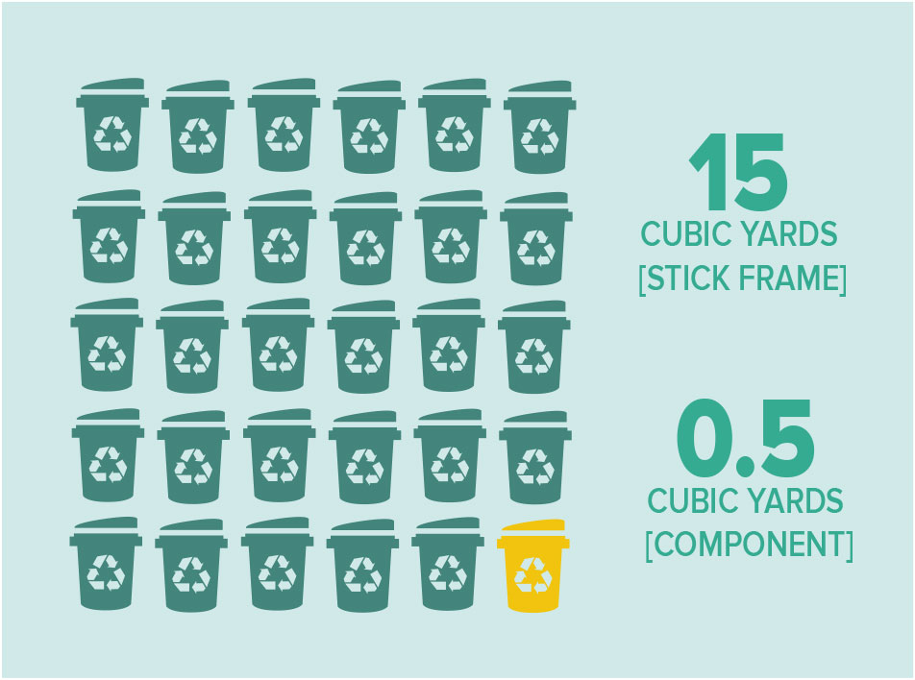
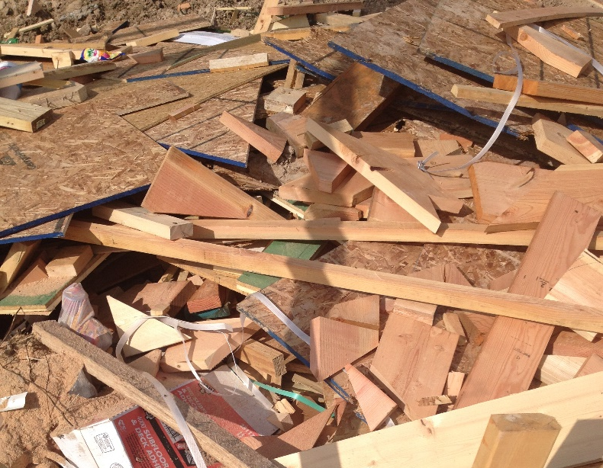
What About Waste?
The stick-framed house produced significant jobsite waste, almost 15 cubic yards, or roughly 102 standard 32 gallon trash cans (a 15 yard dumpster).
Framing the American Dream is an initiative of SBCA

