Slide 1
Fire Resistance Rated Truss Assemblies
Educational Overview

Slide 2
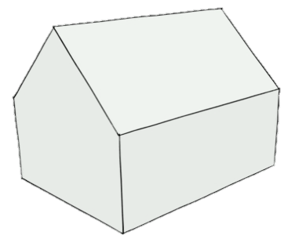
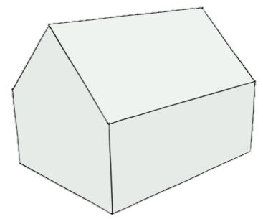
Introduction
Building codes may require a fire endurance rating for several applications where trusses are used:
  Floor/ceiling
  Roof/ceiling
  Attic separation

Slide 3
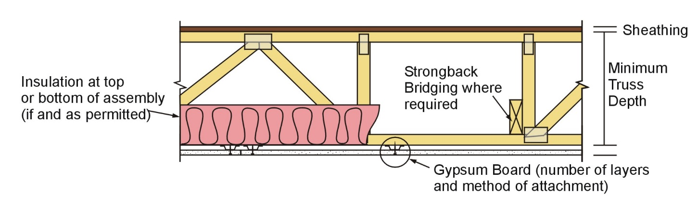
Generic fire rated wood truss assembly

Slide 4
Introduction
Truss protection in fire resistance rated assemblies is covered in the IBC
States that requirements shall be based on “the results of full-scale tests or combinations of tests” or “approved calculations based on such tests” that demonstrate fire resistance
704.5 Truss protection.

Slide 5
Key Definitions
Approved Source: An independent person, firm or corporation, approved by the building official, who is competent and experienced in the application of engineering principles to materials, methods or systems analyses.
Fire Resistance: That property of materials or their assemblies that prevents or retards the passage of excessive heat, hot gases or flames under conditions of use.
Fire-Resistance Rating: The period of time a building element, component or assembly maintains the ability to confine a fire, continues to perform a given structural function, or both, as determined by the tests, or the methods based on tests, prescribed in Section 703.

Slide 6
Introduction
The IBC allows five methods for determining fire resistance (Section 703.3):
  Fire-resistance designs documented in sources.
  Prescriptive designs of fire-resistance-rated building elements, components or assemblies as prescribed in Section 721.
  Calculations in accordance with Section 722.
  Engineering analysis based on a comparison of building element, component or assemblies designs having fire‑resistance ratings as determined by the test procedures set forth in ASTM E119 or UL 263.
  Alternative protection methods as allowed by Section 104.11.

Slide 7
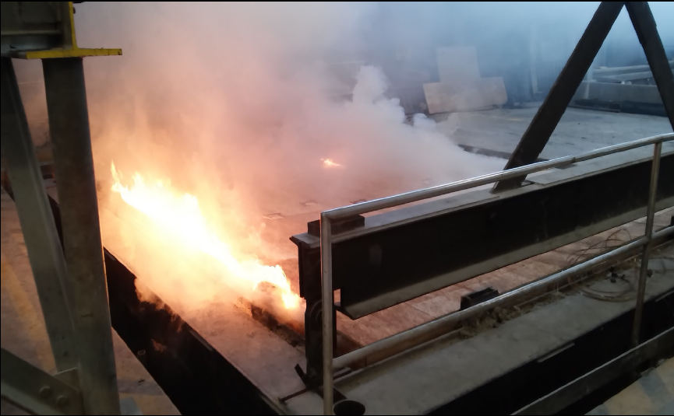
Method 1: Documented fire-resistance designs
To qualify as a documented design, testing is performed in accordance with one of the following tests:
  ASTM E119 Standard Methods for Fire Tests of Building Construction and Materials
  ANSI/UL 263 Fire Resistance Ratings

Slide 8
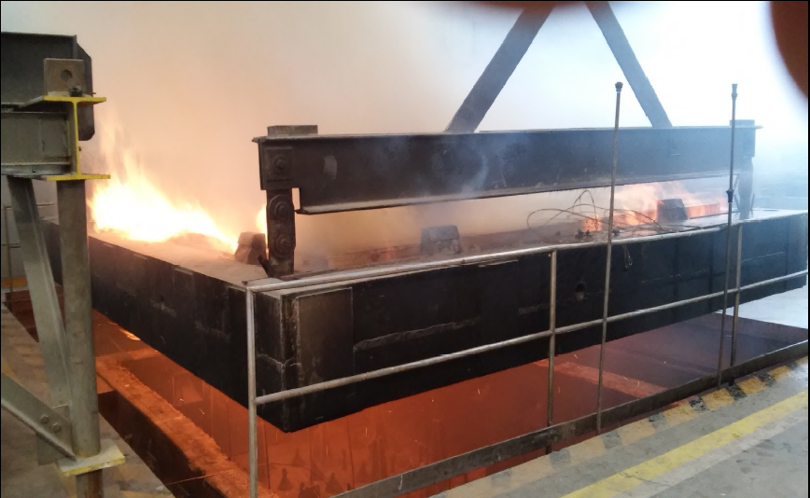
Method 1: Documented fire-resistance designs
Tested assemblies may be specified where a rated assembly is required
Assemblies can generally be applied to both floor and roof applications

Slide 9
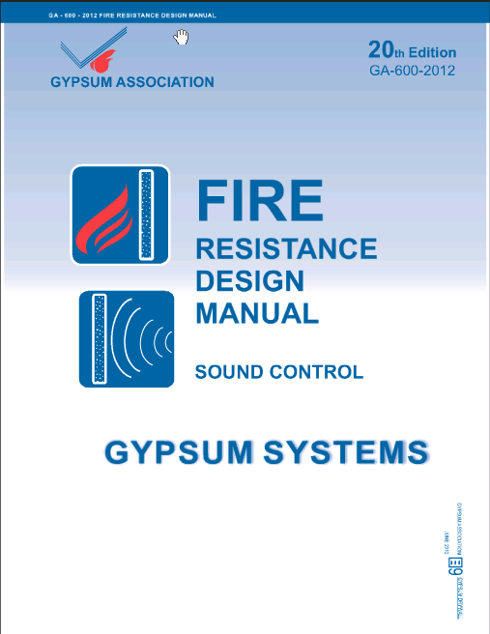
Method 1: Documented fire-resistance designs
Some sources of documented fire-resistance designs include:
Gypsum Association
  Fire Resistance Design Manual (GA-600)
  Online Manual (read only)

Slide 10
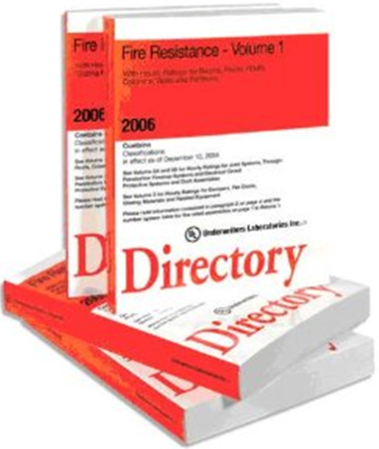
Method 1: Documented fire-resistance designs
Underwriters Laboratories:
  Fire Resistance Directory
  Searchable Database
  Many UL tested designs can also be found in the product literature of companies whose products are certified to be listed in the assemblies

Slide 11



Method 1: Documented fire-resistance designs
Other sources of documented fire-resistance designs include:
  Warnock Hersey (Intertek Directory)
  Factory Mutual
  PFS Corporation

Slide 12

Method 1: Documented fire-resistance designs
General:
  The fire resistance rating of listed assemblies applies to the entire assembly
  Components are NOT intended to be interchanged between assemblies.
Modifications?

Slide 13
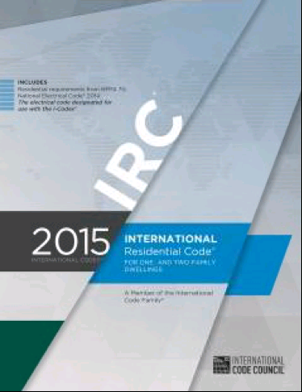
Method 1: Documented fire-resistance designs
However, evaluation by comparison of tested assemblies is permitted by IBC Section 703.3 Method 4.

Slide 14
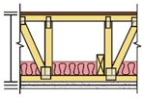
Method 1: Documented fire-resistance designs
Depth/Spacing:
  Depths given are minimums
    Greater depths are allowed
  Spacings given are maximums
    Smaller spacings are allowed
Minimum depth
Maximum spacing

Slide 15
Method 1: Documented fire-resistance designs
Insulation:
  Some assemblies allow addition of insulation if an additional layer of gypsum is installed at the ceiling.
Modifications?

Slide 16
Method 1: Documented fire-resistance designs
However, IBC Section 703.3 Method 4 and Method 5 permit modifications to assemblies
This would include modifications involving insulation
  Rational design must be provided to the building official

Slide 17
Method 1: Documented fire-resistance designs
Use of floor/ceiling designs for roof/ceiling (or reverse):
  UL BXUV.GuideInfo Section III.19 states:
    Class A, B or C roof coverings may be used on floors without reducing the fire-resistance rating
    A nailer of equal thickness to the length of the mechanical fasteners must be added to the flooring

Slide 18
Method 1: Documented fire-resistance designs
Use of floor/ceiling designs for roof/ceiling (or reverse):
  The reverse case is not typical
  Floor/ceiling designs that specify a finish floor cannot be used as roof/ceiling assemblies

Slide 19
Method 1: Documented fire-resistance designs
However, IBC item 4 or item 5 would allow use of assemblies tested as floor/ceiling or roof/ceiling in the other application, even if not specified as such in the listing
  Rational design must be provided to the building official.

Slide 20
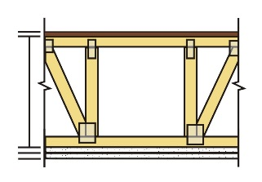
Method 2: Prescriptive designs
IBC Table 721.1(3), item 21-1.1 describes one prescriptive 1-hour rated floor or roof assembly that includes wood trusses:
Base layer: 5/8" Type X gyp attached w/1-1/4” Type S or W drywall screws @ 24” o.c. at right angles to truss/joist
Face layer: 5/8" Type X gyp or veneer base attached thru base layer w/1-7/8” Type S or W drywall screws 12” o.c. at joints and intermediate truss/joist. Type G drywall screws placed 2” back on either side of face layer end joints @ 12” o.c.
1/2" (min) WSP glued & attached w/8d nails at right angles to truss/joist
Max spacing 24”

Slide 21
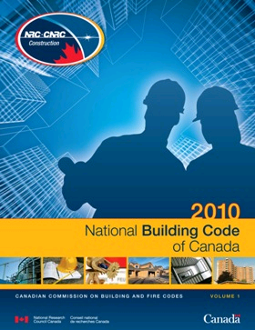
Method 2: Prescriptive designs
The National Building Code of Canada (NBC) 2010 provides an extensive listing of prescriptive assemblies that include metal plate connected wood trusses in Table A-9.10.3.1.B.
These listings also include sound ratings, so can be very useful to the building designer.

Slide 22
Method 3: Calculated designs
IBC Section 722.6 addresses fire resistance calculations for wood assemblies
  The unexposed side membrane is NOT included in the calculation
Fire-exposed side membrane
+
Framing members
+
Other (e.g. Insulation)
=
Fire-resistance rating (minutes)

Slide 23
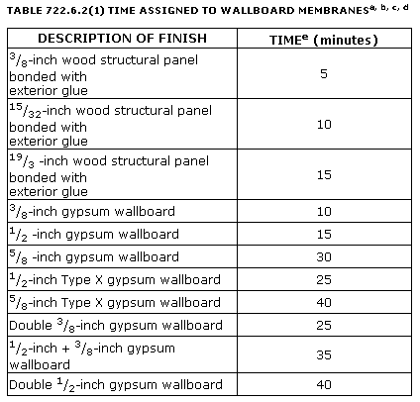
Method 3: Calculated designs
The maximum fire-resistance rating allowed using this method is 1-hour.
This section includes tables with times assigned to both structural members and membranes.

Slide 24
Method 4: Comparison
The IBC allows the determination of fire resistance ratings based on a comparison of building element, component or assembly designs having fire-resistance ratings as determined by the test procedures set forth in ASTM E119 or UL 263.

Slide 25
Method 4: Comparison
Combined with the provisions of IBC Section 104.11 listed at item 5, this allows the building official to approve a design that "complies with the intent of the provisions of this code, and that the material, method or work offered is, for the purpose intended, at least the equivalent of that prescribed in this code in quality, strength, effectiveness, fire resistance, durability and safety."

Slide 26
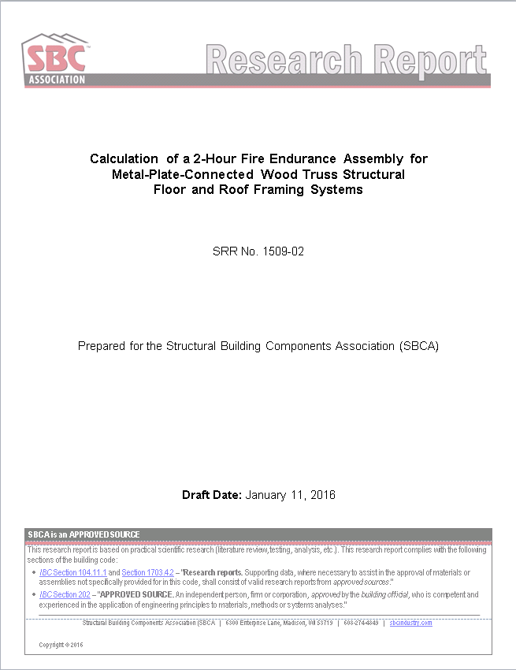
Method 4: Comparison
SBCA has calculated a two hour fire rated MPCWT assembly based on this provision
See SBCA SRR 1509-02 for full details

Slide 27
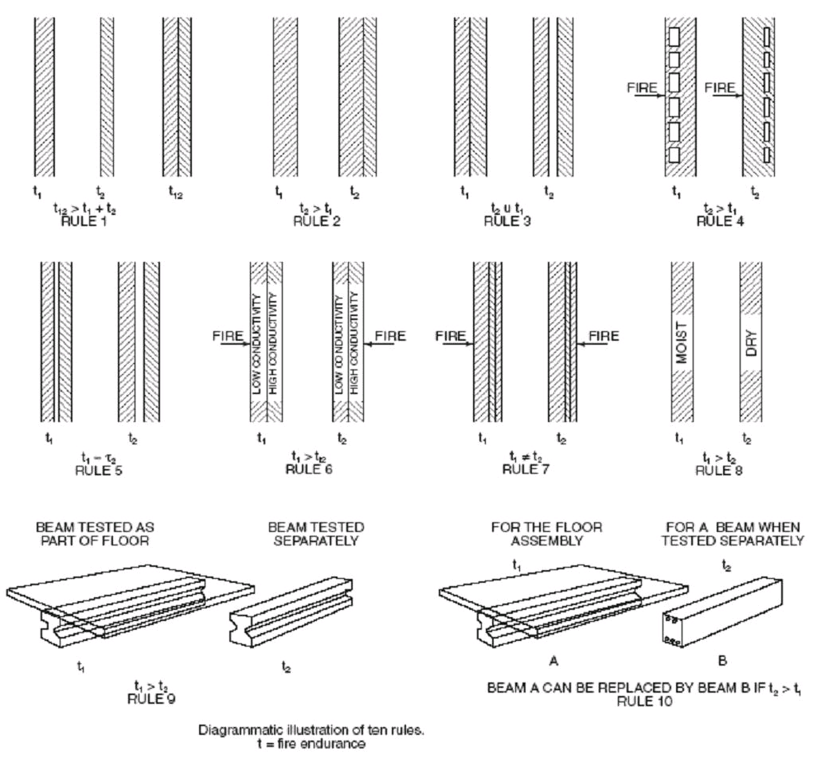
Method 4: Comparison
One basis for this type of analysis is Harmathy’s “Ten Rules of Fire Endurance Rating”
Consult Section 4-13 in the SFPE Handbook of Fire Protection Engineering for further info

Slide 28
Method 5: Alternative materials and methods
104.11 Alternative materials, design and methods of construction and equipment.
  The provisions of this code are not intended to prevent the installation of any material or to prohibit any design or method of construction not specifically prescribed by this code, provided that any such alternative has been approved. An alternative material, design or method of construction shall be approved where the building official finds that the proposed design is satisfactory and complies with the intent of the provisions of this code, and that the material, method or work offered is, for the purpose intended, at least the equivalent of that prescribed in this code in quality, strength, effectiveness, fire resistance, durability and safety.

Slide 29

Method 5: Alternative materials and methods
This allows for other methods of developing a design by an approved source that complies with the intent of the code and, unless it can be demonstrated not to comply with the code, should be approved by the building official.

Slide 30
Conclusion
A Building Designer may submit to a code jurisdiction a fire resistance rated design incorporating metal plate connected wood trusses using any of the five methods allowed by Section 703.3.
If it is not a listed design, the Building Designer should submit details regarding how the submitted design was determined and show how it complies with the intent of the building code.

Slide 31
References
SBCA Research Report 1509-01
National Design Specification® for Wood Construction (NDS®) 2012 or 2015, American Wood Council (AWC), Section 16, Fire Design of Wood Members.
Analytical methods for determining fire resistance of timber members, Robert White, 2008, included in the SFPE handbook of fire protection engineering. Quincy, Mass.; National Fire Protection Association; Bethesda, Md.: Society of Fire Protection Engineers, c2008: pages 4.346-4.366.
Guidelines on Fire Ratings of Archaic Materials and Assemblies. International Code Council (ICC).
National Building Code of Canada, 2010.

Slide 32
References
International Building Code (IBC), 2012 and 2015, International Code Council (ICC).
BXUV.GuideInfo, Underwriters Laboratory.
Gypsum Association Handbook, GA-600, 2012
Fire Resistance Provided by Gypsum Board Membrane Protection, GA-610, 2013
ESR-1338, Gypsum Wall and Ceiling Assemblies and Gypsum Board Interior and Exterior Applications
Intertek Directory of Certified Products
PFS Corporation
Factory Mutual

