Slide 1
Single Membrane Floor Protection
Overview
Revised 3/23/2017

Slide 2
SBCA has been the voice of the structural building components industry since 1983, providing educational programs and technical information, disseminating industry news, and facilitating networking opportunities for manufacturers of roof trusses, wall panels and floor trusses. SBCA endeavors to expand component manufacturers’ market share and enhance the professionalism of the component manufacturing industry.
Copyright © 2017 Structural Building Components Association.

Slide 3
Introduction
Structural Building Components Association (SBCA) and its members strongly believe in providing structural building component solutions that safeguard the public health, safety and general welfare, while serving the general public’s desire to have affordable and environmentally responsible built construction.

Slide 4
Introduction
Likewise, the International Residential Code (IRC) includes the following:
R101.3 Intent. The purpose of this code is to establish minimum requirements to safeguard the public safety, health and general welfare through affordability, structural strength, means of egress facilities, stability, sanitation, light and ventilation, energy conservation and safety to life and property from fire and other hazards attributed to the built environment and to provide safety to fire fighters and emergency responders during emergency operations.

Slide 5
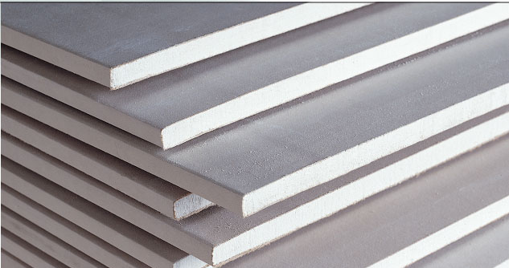
Introduction
SBCA’s general policy is:
Unless there is sufficient comparative data provided to show increased life-safety risk, any regulation created shall be structural element independent so that trade is not inappropriately restricted and a level competitive playing field is assured.
This report aims to enhance fire performance and fire safety characteristics through the application of a gypsum wallboard membrane.

Slide 6
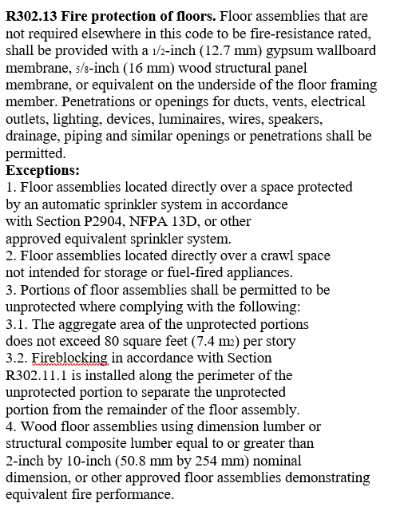
Introduction
The requirements included in 2012 IRC Section R501.3 / 2015 IRC Section R302.13 do not meet the intent of the code change proposal adding this section (protection of the fire service)
Nor do they reflect the most current data on the fire performance of unprotected floor systems.
Several IRC code change proposals were submitted in 2009 regarding the fire protection of floor systems.
Some proposals required 30 minute protection
Some required 15 minute protection

Slide 7
Background
Sources of test reports referenced by these proposals included:
National Research Council of Canada
Tyco Fire Suppression and Building Products
Underwriters Laboratories (UL)
The UL report was commissioned by the Chicago Fire Department and the International Association of Fire Chiefs under a grant from the Department of Homeland Security.

Slide 8
Background
Additional testing was done by:
National Research Council of Canada
Underwriters Laboratories (UL)
Funded by National Institute of Standards and Technology’s (NIST) American Recovery and Reinvestment Act Grant Program.
The stated goal was “to improve firefighter safety by increasing the level of knowledge on the response of residential flooring systems to fire.” The results of this testing provides data that was not readily available at the time the code change was introduced.

Slide 9
Application
The following is the code requirement included in 2015 IRC Section R302.13.
Besides moving the requirement from 2012 IRC Section R501.3, the sentence in red was added in the 2015 edition.
Floor assemblies, not required elsewhere in this code to be fire resistance rated, shall be provided with a ½-inch gypsum wallboard membrane, 5/8-inch wood structural panel membrane, or equivalent on the underside of the floor framing member. Penetrations or openings for ducts, vents, electrical outlets, lighting, devices, luminaires, wires, speakers, drainage and similar openings or penetrations shall be permitted.
Exceptions:
Floor assemblies located directly over a space protected by an automatic sprinkler system in accordance with Section P2904, NFPA 13D, or other approved equivalent sprinkler system.
Floor assemblies located directly over a crawl space not intended for storage or fuel-fired appliances.
Portions of floor assemblies shall be permitted to be unprotected where complying with the following:
3.1 The aggregate area of the unprotected portions does not exceed 80 square feet (7.4 m2) per story
3.2 Fireblocking in accordance with Section R302.11.1 is installed along the perimeter of the unprotected portion to separate the unprotected portion from the remainder of the floor assembly.
4. Wood floor assemblies using dimension lumber or structural composite lumber equal to or greater than 2-inch by 10-inch (50.8 mm by 254 mm) nominal dimension, or other approved floor assemblies demonstrating equivalent fire performance.

Slide 10
Application – UL
Underwriters Laboratories report, Improving Fire Safety by Understanding the Fire Performance of Engineered Floor Systems and Providing the Fire Service with Information for Tactical Decision Making, addresses many of the concerns of the fire service regarding the above code language, especially with exception #4.
Wood floor assemblies using dimension lumber or structural composite lumber equal to or greater than 2-inch by 10-inch (50.8 mm by 254 mm) nominal dimension, or other approved floor assemblies demonstrating equivalent fire performance.

Slide 11
Application – UL
The following is from the summary of the UL report:
The results of the study have been prepared to provide tactical considerations for the fire service to enable improved decision making on the fire scene.
There are several tactical considerations that result from this research that firefighters can use immediately to improve their understanding, safety and decision making when sizing up a fire in a one or two family home.
Collapse times of all unprotected wood floor systems are within the operational time frame of the fire service regardless of response time.

Slide 12
Application – UL
Size-up should include the location of the basement fire as well as the amount of ventilation. Collapse always originated above the fire and the more ventilation available the faster the time to floor collapse.
When possible the floor should be inspected from below prior to operating on top of it. Signs of collapse vary by floor system:
Dimensional lumber should be inspected for joist rupture or complete burn through,
Engineered I-joists should be inspected for web burn through and separation from subflooring,
Parallel Chord Trusses should be inspected for connection failure,
Metal C-joists should be inspected for deformation and subfloor connection failure.
Sounding the floor for stability is not reliable and therefore should be combined with other tactics to increase safety.

Slide 13
Application – UL
Thermal imagers may help indicate there is a basement fire but can’t be used to assess structural integrity from above.
Attacking a basement fire from a stairway places firefighters in a high-risk location due to being in the flow path of hot gases flowing up the stairs and working over the fire on a flooring system, which has the potential to collapse due to fire exposure.
It has been thought if a firefighter quickly descended the stairs, cooler temperatures would be found at the bottom of the basement stairs. The experiments in this study showed that temperatures at the bottom of the basement stairs where often worse than the temperatures at the top of the stairs.

Slide 14
Application – UL
Coordinating ventilation is extremely important. Ventilating the basement created a flow path up the stairs and out through the front door of the structure, almost doubling the speed of the hot gases and increasing temperatures of the gases to levels that could cause injury or death to a fully protected firefighter.
Floor sag is a poor indicator of floor collapse, as it may be very difficult to determine the amount of deflection while moving through a structure.

Slide 15
Application – UL
Gas temperatures in the room above the fire can be a poor indicator of both the fire conditions below and the structural integrity of the flooring system.
Charged hose lines should be available when opening up void spaces to expose wood floor systems.
During all of these controlled experiments where the variables were systematically controlled there were no reliable and repeatable warning signs of collapse. In the real world, the fire service will never respond to two fires that are exactly the same.

Slide 16
Application – UL
The UL report’s stated objectives include the following:
Understanding the impact of span, fuel load, ventilation and fire location to system failure.
Examine different fire protection methods and develop data to assess their effectiveness.
Provide scientific data to substantiate code changes related to residential floor systems to result in improved building fire safety.

Slide 17
Application – UL
The UL report first investigated the time to failure of dimensional lumber floor assemblies as shown in Table 23, page 51

Slide 18
Application – UL
The UL report addresses the operational timeframe and includes the following statistics:
Every fire department has a wide range of response times within their response area depending on factors such as distance from the fire station, type of fire department and time of day just to name a few. In an analysis done by the United States Fire Administration (USFA) in 2006 they conclude, “In most of the analyses done here, response times were less than 5 minutes nearly 50% of the time and less than 8 minutes about 75% of the time. Nationally, average response times were generally less than 8 minutes. The overall 90th percentile, a level often cited in the industry, was less than 11 minutes.” (USFA, 2006)
These response times don’t take into consideration the time between ignition and notification to the fire department to begin their response. It is important to note that the fire department rarely knows when the fire started. Conservatively for this discussion let’s assume that it takes 4 minutes from the time of ignition, for the fire to be discovered, for the fire department to be notified and for the fire department to begin their response.

Slide 19
Application – UL
The conclusions regarding exception #4, which allows 2-inch by 10-inch nominal lumber or larger to be unprotected, are given on page 64, 66 & 69, see especially the bolded sentences:
“…Based on the collapse times from these experiments there is little to no safe operating time for firefighters in a structure with an unprotected dimensional lumber floor system.”
“...Protecting the dimensional lumber as well as engineered lumber floor systems in future code requirements would eliminate this fire performance change in dimensional lumber and provide a more reasonable factor of safety for the fire service.”

Slide 20
Application – UL
“This assumes the fire is witnessed, called into the fire department, the fire department is dispatched, the fire department arrives and the fire department begins their firefighting operation in 8 minutes. While possible, this is not the case for the majority of fires that occur across the United States. This emphasizes the importance of protecting all types of flooring system, including dimensional lumber.”
There are several exceptions in the code language that were examined in this research project. One exception is that there is no protection required for dimensional lumber floor systems. This research study provides data to substantiate the need to protect dimensional lumber floor systems to improve firefighter safety. The second exception examined was the allowance of an exposed 80 ft² exposed area. Limiting the fuel load in relation to the exposed floor area or placing the exposed floor area in a separate room from the finished section of the basement would increase the safety when the floor area must be exposed.

Slide 21
Application – SBCA Testing
SBCA recently undertook testing at NGC Testing Services (NGC), an International Accreditation Service (ICC-IAS) accredited ISO/IEC 17025 ASTM E119 fire testing facility.
SBCA chose to test at NGC versus UL so the SBCA ASTM E119 test procedure and resulting test data would be an independent assessment of floor assembly performance.

Slide 22
Application – SBCA Testing
SBCA testing found unprotected 2x10 floor assembly performance was 10:35 minutes.
This result confirms the UL testing results for dimension lumber and I-joists and adds information regarding trusses.

Slide 23
Application – SBCA Testing
Testing illustrates metal plate connected wood floor trusses with strongbacks perform similarly to 2x10 wood joists.
However, neither meets the expected 15 minutes of fire performance.

Slide 24
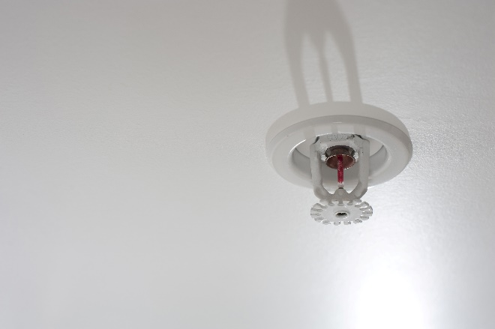
Conclusion
The following practices are STRONGLY recommended based on test data and good science:
Use ½” gypsum wallboard on all unprotected structural elements
Excluding uninhabited or mechanical spaces.
Use automatic sprinklers throughout.

Slide 25
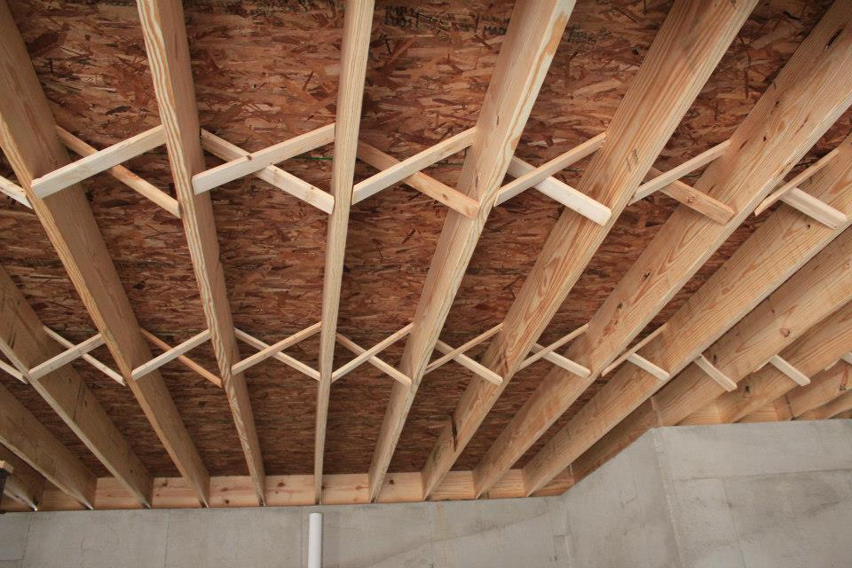
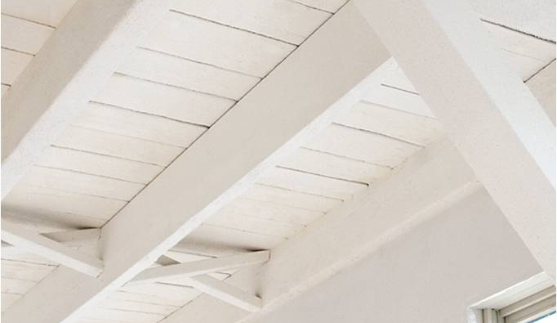
Conclusion
The following practices are NOT advisable based on test data and good science:
Unprotected 2x10 floor assemblies
Use of 2x10 joists also effectively and arbitrarily limits the use of trusses and I-joists
Use of current dimensional lumber for joists
Does not perform in fire conditions like older dimensional lumber
Fire retardants or intumescent coatings intended to provide equivalent protection to a ½” layer of gypsum

Slide 26
Conclusion
If a fire fighter dies on an unprotected 2x10 floor, that may invite questions of responsibility from policy-makers:
Could this public policy be classified as negligent, considering the supporting test results?
How do policy-makers evaluate the risks, given it is their job to safeguard public safety, health and general welfare?

Slide 27
Conclusion
Jurisdictions should not adopt 2012 IRC Section R501.3 or 2015 IRC Section R302.13
Regardless of local building code adoption, ceiling protection in wooden floor assemblies is strongly advised based on testing and good science.
In jurisdictions that are evaluating adoption of the 2012 or 2015 IRC we highly recommend they eliminate exception number 4, thus requiring all floor systems to include ceiling protection.

Slide 28
References
Underwriters Laboratories, Improving Fire Safety by Understanding the Fire Performance of Engineered Floor Systems and Providing the Fire Service with Information for Tactical Decision Making, 2012. Available online.
NGC Testing Services, Reports FC-853, FC-858, FC855, FC-854, FC-855, FC-856, March, 2015
National Institute for Occupational Safety and Health Report F2006-26. July, 2007.
National Institute for Occupational Safety and Health Report F2007-12, May, 2008.
National Institute for Occupational Safety and Health Report F2006-24, September, 2007.
National Institute for Occupational Safety and Health Report F2007-07, November, 2007.
National Institute for Occupational Safety and Health Alert, “Preventing Injuries and Deaths of Fire Fighters due to Truss System Failures”. Available online.

Slide 29
References
NIST, Examination of the Thermal Conditions of a Wood Floor Assembly above a Compartment Fire, Tech Note 1709, 2011. Available online.
National Institute for Occupational Safety and Health Workplace Solutions, Preventing Deaths and Injuries of Fire Fighters Working Above Fire-Damaged Floors, February, 2009. Available online.
National Research of Canada, Institute for Research in Construction; Fire performance of Houses, Phase I, Study of Unprotected Floor Assemblies in Basement Fire Scenarios, December, 2008. Available online.
National Research of Canada, Performance of Protected Ceiling/Floor Assemblies and Impact on Tenability with a Basement Fire Scenario, IRC-RR-307, 2011. Available online.
Tyco Industries, A Technical Analysis: The Performance of Composite Wood Joists Under Realistic Fire Conditions, September 2008. Available online.
Underwriters Laboratories, Structural Stability of Engineered Lumber in Fire Conditions, September 30, 2008. Available online.
International Residential Code, 2012 & 2015, by the International Code Council.

Slide 30
References
Other SBCA information on this subject:
SBCA’s R501.3 and R302.13 Resource Page
Answering the Question: What Is Equivalent Protection to a 1/2-inch Gypsum Wallboard Membrane?
SBCA’s Views on Creating Fair Code Policy in Contrast to the AWC & NAHB Proposal Effectively Banning Floor Truss and I-joist Use
NIOSH Data Affirms AWC/NAHB Approach to Firefighter Safety not Fact Based
AWC & NAHB Author Original Code Change Proposals Effectively Banning Floor Truss and I-joist Use
How Floor Trusses Became an Endangered Species, the Politics of it All
SBCA Continually Advocates for a Common Sense, Fact-Based Approach to Fire Safety
7 Reasons to Immediately Delete Exception 4 from R501.3

