Slide 1
Position Statement on
Sealed Truss Placement Diagrams for the 2012 or 2015
International Residential Code
Overview
Revised 3/23/2017

Slide 2
SBCA has been the voice of the structural building components industry since 1983, providing educational programs and technical information, disseminating industry news, and facilitating networking opportunities for manufacturers of roof trusses, wall panels and floor trusses. SBCA endeavors to expand component manufacturers’ market share and enhance the professionalism of the component manufacturing industry.
Copyright © 2017 Structural Building Components Association.

Slide 3
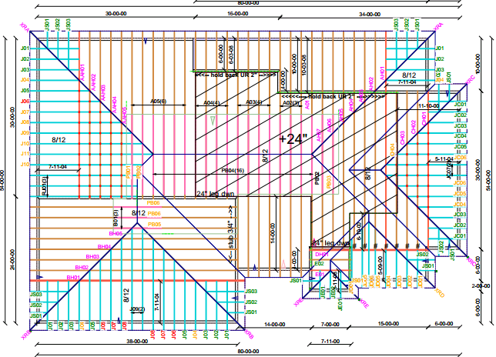
Introduction
Do Truss Designers have the responsibility to seal a Truss Placement Diagram (TPD)?
Short answer: NO

Slide 4
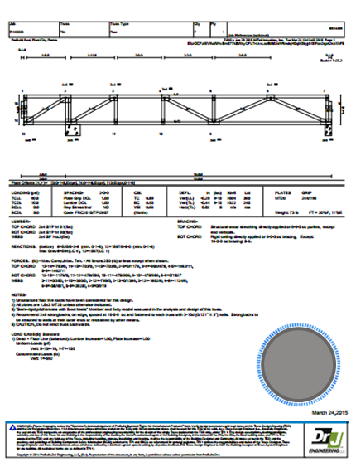
Why not seal TPDs?
All necessary engineering design information is found on the Truss Design Drawings (TDD)
If Truss Design Engineers were to seal a TPD, they could inappropriately be held responsible for ensuring the proper flow of loads through the structure to the foundation.

Slide 5

Why not seal TPDs?
Compare a truss to a window: both are manufactured and in turn installed within a building.
A window may be a highly engineered component of a house with specific installation specifications and instructions.
However, there is no requirement to provide an engineer’s seal on the installation instructions for windows.

Slide 6
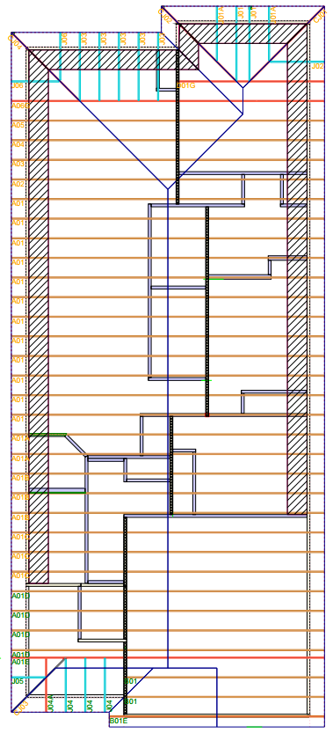
Purpose of TPDs
To assist the builder in positioning or locating the trusses and components supplied by the manufacturer.
To serve as detailed installation instructions
To indicate the manufacturer’s assumed location for each truss and component

Slide 7
Background
The majority of residential structures in the United States are built using the prescriptive code of the IRC.
Trusses are simply replacements for the prescriptively applied joists and rafters, and are highly engineered structural elements.
The following information should be used to provide insight into why component manufacturers should seriously consider all the ramifications of providing seals on TPD for projects governed by the 2012 or 2015 IRC.

Slide 8
Background
The Truss Design Engineer is NOT the Building Designer.
A Truss Design Engineer could only undertake Building Designer responsibilities under a special set of circumstances and when they are delegated the appropriate scope of work as a Successor Engineer.
This would require authorization from the owner of the project and a contract to do so, along with being professionally capable of taking on such responsibility and being compensated for doing so.

Slide 9
Background
While the IRC remains relatively silent on the issue, since the 2006 edition, the IBC has provided specific language regarding TPD:
  2006 IBC 2303.4.3 Truss Placement Diagram. A diagram supplied by the truss manufacturer that identifies the proposed location for each individually designated truss and references the corresponding Truss Design Drawing. The Truss Placement Diagram shall be provided as part of the job site. Truss Placement Diagrams shall not be required to bear the seal or signature of the Truss Designer.
  Exception: When the Truss Placement Diagram is prepared under the direct supervision of a registered design professional, it is required to be signed and sealed.

Slide 10
Background
In the 2009 IBC the definition of a TPD was revised again (S217-07/08) as proposed by the National Council of Structural Engineers Associations (NCSEA):
  2303.4.2 Truss placement diagram. The truss manufacturer shall provide a truss placement diagram that identifies the proposed location for each individually designated truss and references the corresponding truss design drawing. The truss placement diagram shall be provided as part of the truss submittal package, and with the shipment of trusses delivered to the job site. Truss placement diagrams that serve only as a guide for installation and do not deviate from the permit submittal drawings shall not be required to bear the seal or signature of the truss designer.

Slide 11
Background
The rationale for the change proposed by S217-07/08 is as follows:
  The truss placement diagram is an erection diagram that replicates the information on the approved construction documents per Section 106.3. As it requires no engineering input, direct supervision and the signature and seal of a registered design professional is not required.

Slide 12
Background
The Commentary to the 2012 IBC Section 2303.4.2 provides further background on the intent of the code change.
  This section describes and defines the term "truss placement diagram." It is intended to minimize the confusion that exists in the construction industry between a variety of terms that are often used interchangeably, such as "installation documents," "construction documents," "shop drawings," etc. The term "truss placement diagram" is preferred by the truss industry and is very specific. The section requires a truss placement diagram to identify the location of each truss and references the corresponding truss design drawing to facilitate inspection and proper installation.

Slide 13
Analysis – IRC
The IRC does not reference the TPD but does specifically state what information needs to be on a TDD and that the TDD needs to be prepared by a Truss Design Engineer
On the contrary, the IBC does include relevant sections that lay out the differences between TDDs and TPDs
2012 IRC Section R502.11.4 and Section R802.10.1
2015 IRC Section R502.11.4 and Section R802.10.1
2012 IRC Section R502.11.1 and Section R802.10.2
2015 IRC Section R502.11.1 and Section R802.10.2
2012/2015 IBC Section 2303.4

Slide 14
Analysis – IRC
The IRC provides that the plans and specifications for a project shall be prepared by a licensed architect or engineer where required by the law of the jurisdiction in which the project is being constructed.
The plans and specifications should in turn clearly define the scope of the work proposed by the Building Designer.
2012 IRC Section R106.1
2015 IRC Section R106.1
2012 IRC Section R106.1.1
2015 IRC Section R106.1.1

Slide 15
Analysis – Statutes for Professional Engineering
A state’s professional engineering law(s) and the IBC provide the basis upon which to evaluate the need to provide an engineer’s seal on a TPD.
Requiring the TPD to be sealed, where it is not prepared by an engineer or under his/her immediate personal supervision, is contrary to most state engineering laws which typically include language regarding sealing construction documents.
Based on the above, a TPD does not require a professional engineer’s seal for any building project in jurisdictions with similar statutes.

Slide 16
Analysis – ANSI/TPI 1
ANSI/TPI 1, referenced by both the 2015 (14) and 2012 (07) IBC, clearly states that TPDs do not require an engineer’s seal when they serve only as a guide for Truss installation
The commentary further explains the intent of the standard
2.3.6.4 Truss Placement Diagram. …When the Truss Placement Diagram serves only as a guide for Truss installation and requires no engineering input, it does not require the seal of any Truss Design Engineer or Registered Design Professional.

Slide 17
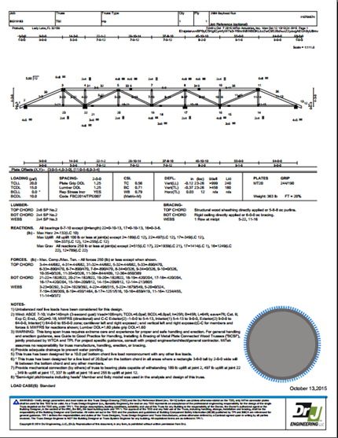
Analysis – ANSI/TPI 1
The Truss Designer’s sole responsibility is to design the individual trusses according to information provided by the RDP or Building Designer
The Truss Designer is therefore specifically responsible for the single truss design depicted on each TDD.

Slide 18
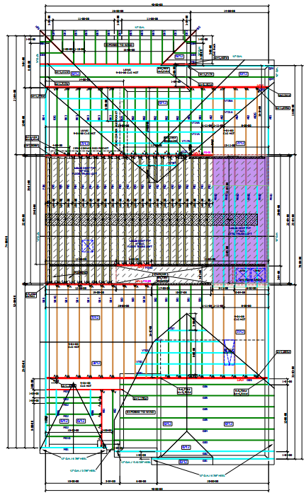
Analysis – ANSI/TPI 1
TPDs are typically prepared by component manufacturer personnel other than Truss Designers.
The TPDs may not be reviewed or even seen by the Truss Designer.
It is therefore understood that TPDs are not prepared under the Truss Designer’s direct supervision.

Slide 19
Findings
Although the 2012 and 2015 IRC do not address the TPD, the code referenced standard ANSI/TPI 1 specifically states that the TPD does not require the Truss Design Engineer’s seal when it serves only as a guide for truss installation.
Per 2012 IRC Section R102.4 and 2015 IRC Section R102.4, the standards referenced in this code shall be considered part of the requirements of this code to the prescribed extent of each such reference.

Slide 20
Conclusion
Truss Design Engineers should NOT be asked by RDPs, Building Designers or Building Code Officials to seal TPDs.

Slide 21
References
ANSI/TPI 1, National Design Standard for Metal Plate Connected Wood Truss Construction, Truss Plate Institute, 2007, 2014
International Residential Code / International Building Code, International Code Council, 2006, 2009, 2012, 2015

