Slide 1
IRC Fire Protection of Floors Code Language 2012 IRC R501.3 2015 IRC R302.13

Slide 2
Current IRC Code Adopted into Some State Laws R501.3 Fire Protection of Floors
Floor assemblies, not required elsewhere in this code to be fire resistance rated, shall be provided with a ½ inch gypsum wallboard membrane, 5/8 inch wood structural panel membrane, or equivalent on the underside of the floor framing member.
[IBC Section 722.6.2 defines “Time Assigned to Wallboard Membranes” – ½ inch gypsum wallboard being 15 minutes plus the time of what it is attached to.]
Exceptions:
Floor assemblies located directly over a space protected by an automatic sprinkler system in accordance with Section P2904, NFPA13D, or other approved equivalent sprinkler system.
Floor assemblies located directly over a crawl space not intended for storage or fuel-fired appliances.

Slide 3
Current IRC Code Adopted into Some State Laws R501.3 Fire Protection of Floors
3. Portions of floor assemblies can be unprotected when complying with the following:
3.1 The aggregate area of the unprotected portions shall not exceed 80 square feet per story.
3.2 Fire blocking in accordance with Section R302.11.1 shall be installed along the perimeter of the unprotected portion to separate the unprotected portion from the remainder of the floor assembly.
4. Wood floor assemblies using dimension lumber or structural composite lumber equal to or greater than 2-inch by 10-inch nominal dimension, or other approved floor assemblies demonstrating equivalent fire performance.

Slide 4
IRC Fire Protection of Floors 2012 Report and Test Results by UL

Slide 5
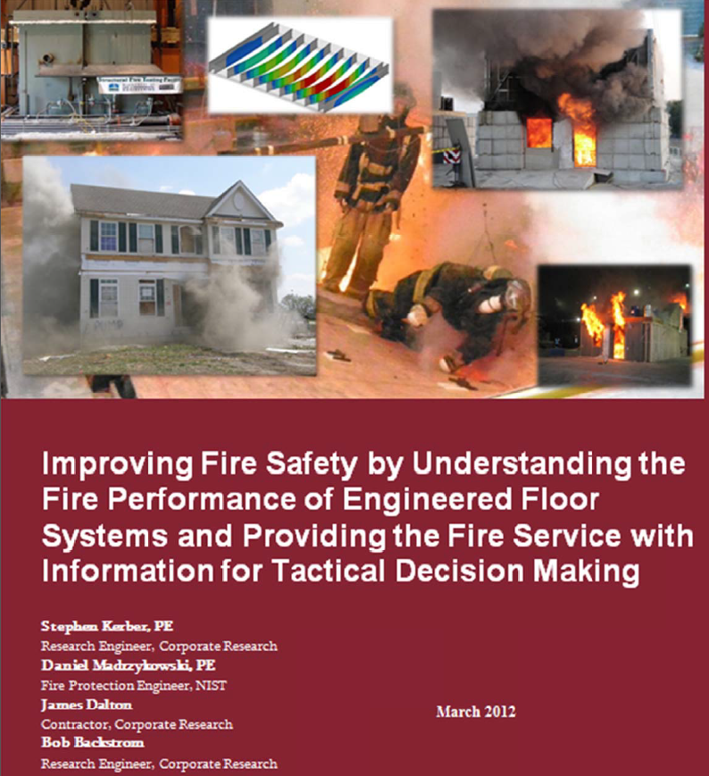
Fire Protection of Floors Global Fire Research Site UL Report Findings (PDF)

Slide 6
UL Residential 2x10 Floor Construction Fire Test Video Floor Collapses at 6:55 minutes

Slide 7
Furnace Test Results
First Column -- Time Of Structural Failure for the Assembly (m/s)
Second Column – Failure of Load Bearing Capacity for the Assembly (m/s)
1. Engineered I Joists with Openings 8:10 6:10
2. Engineered Wood and Metal Hybrid Trusses 5:30 4:20
3. Engineered I Joists (100% Load) 2:20 2:20
4. Engineered I Joists w/ Fire Retardant Coating 8:40 7:50
5. Nominal 2” by 10” Dimensional Lumber (100% Load) 7:04 7:04
6. 1940 Legacy Nominal 2” by 8” Dimensional Lumber (100% Load) 18:05 17:40
Notes:
The furnace test results are compelling.
The XJ-85 actually performed a bit better than the solid 12” engineered I-joist. This was most likely due to the increased thickness of the webbing. In order to support the load, with the openings cut into the web, the manufacturer had to increase the width of the I-joist. This added mass to the web allowing it to perform for a longer period of time.
The intumescent coating actually added a substantial amount of time to the collapse time of the I-joists. Again this product is not designed nor marketed for application to wood products as it can deteriorate the wood over a period of time.
Notice how quickly the unprotected I-joist failed when subjected to the test with 100% of the design load as a true ASTM E-119 test requires. This was a significant reduction of time from the modified load in earlier demonstration tests.
The fire retardant product that markets itself as an equivalent to gypsum board did not perform so well when subjected to a true load bearing E-119 test. This highlights the importance of using the correct test when evaluating the performance of a product in estimating the load carrying capabilities.
We can also see the performance of today’s lumber with the early collapse of a modern lumber 2 x 10 dimensional lumber floor assembly. Remember we are comfortable with dimensional lumber and there is no difference between yesterday’s lumber and today’s. Do you feel comfortable.
The final test was to compare the belief that wood today has a different performance time. The UL staff procured a floor assembly from a single family home built in 1940 in Cleveland, Ohio. They had to use 2 x 8 because that was the dimension used during that period to carry the load. The sample floor was tested using the same sub-floor as today’s floor systems to get an apples to apples comparison of the floor joists performance. Interestingly, the modern 2 x 10 failed in 7:04 and the 1940 2 x 8 didn’t collapse until 18:05. Is there a difference in performance? Let the results be the judge.

Slide 8
IRC Fire Protection of Floors 2015 Confirmation Testing by SBCA

Slide 9
UL and SBCA ASTM E119 100% Design Load Fire Test Data is Aligned – Says Protect Everything

Slide 10
IRC Fire Protection of Floors 2012 Report Recommendations by UL

Slide 11
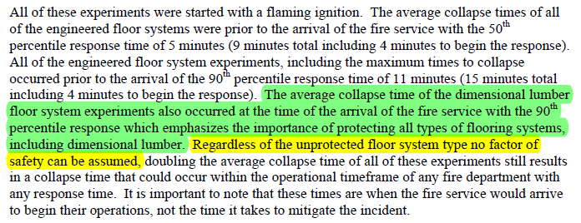
UL Research Finding (Section 7.1 Starting at Bottom of Page 51 and all of Page 52 for Context)

Slide 12
UL Research Findings (Page 67)

Slide 13
UL Research Finding (Pages 3 & 68 on collapse times, Page 64 Section 8.1 on Exception 4 for Context )

Slide 14
Relevant Pennsylvania Law

Slide 15
Pennsylvania Unfair Trade Practice
PA Pennsylvania Unfair Trade Practice Section
The Antitrust Section helps protect the free enterprise system by detecting anti-competitive practices and taking legal action to stop them.
Acting as a watchdog to maintain a free and open marketplace, the section brings legal actions to recover overcharges paid by consumers and state agencies as the result of violations of state and federal antitrust laws.
Competition
When sellers have to compete against each other, each seller will try his or her best to attract buyers. Consumers will therefore have the opportunity to buy higher quality goods at lower prices than they are likely to get without competition.
Competition also promotes efficiency. In order to lower prices and remain profitable, sellers must attempt to cut costs.
The best argument in favor of an economic system based on competition is that it works better than anything anyone else has tried. All over the world, economic systems are crumbling and are being replaced with free markets. Vigorous competition will play an important role in a strong Commonwealth economy.

Slide 16
Pennsylvania Unfair Trade Practice
PA Pennsylvania Unfair Trade Practice Section & “Unfair Trade Practices and Consumer Protection Law.”
Representing that goods or services are of a particular standard, quality or grade, or that goods are of a particular style or model, if they are of another;
Engaging in any other fraudulent or deceptive conduct which creates a likelihood of confusion or of misunderstanding.
§ 201-4. Restraining prohibited acts Whenever the Attorney General or a District Attorney has reason to believe that any person is using or is about to use any method, act or practice declared by section 34 of this act to be unlawful, and that proceedings would be in the public interest, he may bring an action in the name of the Commonwealth against such person to restrain by temporary or permanent injunction the use of such method, act or practice.

Slide 17
Current PA Title 34 Uniform Construction Code
§ 403.21. Uniform Construction Code (UCC).
(a) The Department adopts and incorporates by reference the following codes as the Uniform Construction Code:
(7) The "International Residential Code."
(i) The provisions of R314.4 requiring interconnected smoke alarms do not apply to one-family….
The scope and intent of the UCC is identical to the IRC

Slide 18
Current IRC Code Adopted Intent
SECTION R101 GENERAL
R101.1 Title. These provisions shall be known as the Residential Code for One- and Two-family Dwellings of [NAME OF JURISDICTION], and shall be cited as such and will be referred to herein as "this code.”
R101.2 Scope. The provisions of the International Residential Code for One- and Two-family Dwellings shall apply to the construction, alteration, …… detached one- and two-family dwellings and townhouses not more than three stories above grade plane in height with a separate means of egress and their accessory structures….
R101.3 Intent. The purpose of this code is to establish minimum requirements to safeguard the public safety, health and general welfare through affordability, structural strength, …. energy conservation and safety to life and property from fire… attributed to the built environment and to provide safety to fire fighters and emergency responders during emergency operations.

Slide 19
Summary of UL and SBCA Research and Testing Work

Slide 20
UL States Clearly – All Unprotected Floor Systems are Dangerous – UL and SBCA Testing Confirms these Facts
There is no safe operating time with an unprotected 2x10 floor system.
The collapse time of 2x10 fire test experiments occurred within the time of the arrival of the fire service.
2x10 fire test performance emphasizes the importance of protecting all types of floor systems, including dimensional lumber.
Regardless of what the floor system is made of, no factor of safety can be assumed, if the floor system is unprotected.

Slide 21
SBCA Research Findings and Key Recommendations are Fully Aligned with those of UL
SBCA’s Views on Creating a Consistent and Fair Public Policy and Code Language
Option #1-- Protect all floors with a 15 minute membrane – IBC Chapter 7
Assuming membrane not removed – fire service can expect consistent factor of safety.
Option #2 -- Leave all structural products unprotected
Fast burn times, no factor of safety, but consistent fire ground performance
Least safe – fire ground decision making then has to be conservative
Same as when single membrane removed by any owner.
Option #3 -- Use at least NFPA 13 D sprinkler system; by legislation plumber allowed to install so install is most cost effective. Proven and best fire safety, most expensive.
Fire performance policy needs to be consistent, fair, safe and simple to remember.

Slide 22
To Reduce Most if not All Downstream Unintended Consequences SBCA Recommends the Following R501.3 Modification
Floor assemblies, not required elsewhere in this code to be fire resistance rated, shall be provided with a ½ inch gypsum wallboard membrane, 5/8 inch wood structural panel membrane, or equivalent on the underside of the floor framing member.
[IBC Section 722.6.2 defines “Time Assigned to Wallboard Membranes” – ½ inch gypsum wallboard being 15 minutes plus the time of what it is attached to.]
Exceptions:
Floor assemblies located directly over a space protected by an automatic sprinkler system in accordance with Section P2904, NFPA13D, or other approved equivalent sprinkler system.
Floor assemblies located directly over a crawl space not intended for storage or fuel-fired appliances.
Portions of floor assemblies can be unprotected when complying with the following:
3.1 The aggregate area of the unprotected portions shall not exceed 80 square feet per story.
3.2 Fire blocking in accordance with Section R302.11.1 shall be installed along the perimeter of the unprotected portion to separate the unprotected portion from the remainder of the floor assembly.
Wood floor assemblies using dimension lumber or structural composite lumber equal to or greater than 2-inch by 10-inch nominal dimension, or other approved floor assemblies demonstrating equivalent fire performance.

Slide 23
Any Questions Please Call For NGT Test Reports and Additional Support Information Please call 608-217-3713 as Needed

