Slide 1
Position Statement on
Sealed Truss Placement Diagrams for the State of Texas
Overview
Revised 3/23/2017

Slide 2
SBCA has been the voice of the structural building components industry since 1983, providing educational programs and technical information, disseminating industry news, and facilitating networking opportunities for manufacturers of roof trusses, wall panels and floor trusses. SBCA endeavors to expand component manufacturers’ market share and enhance the professionalism of the component manufacturing industry.
Copyright © 2017 Structural Building Components Association.

Slide 3
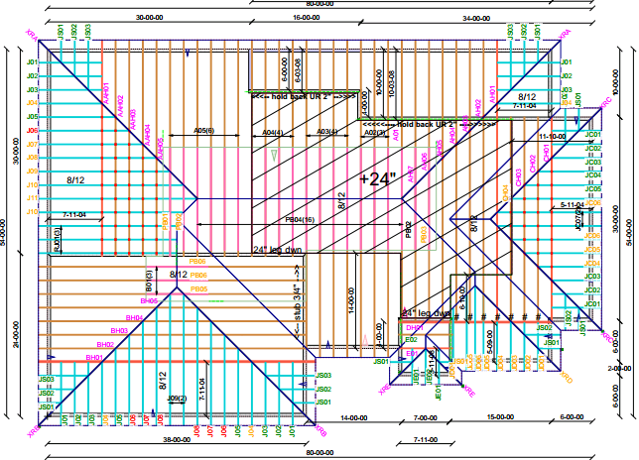
Introduction
Do Truss Designers have the responsibility to seal a Truss Placement Diagram (TPD)?
Short answer: NO

Slide 4
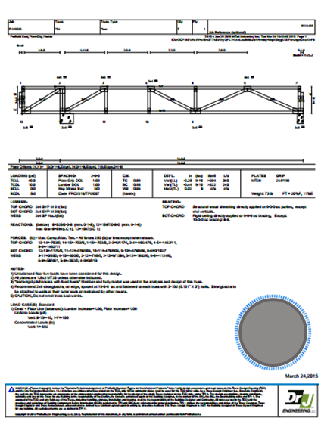
Why not seal TPDs?
All necessary engineering design information is found on the Truss Design Drawings (TDD)
If Truss Design Engineers were to seal a TPD, they could inappropriately be held responsible for ensuring the proper flow of loads through the structure to the foundation.

Slide 5

Why not seal TPDs?
Compare a truss to a window: both are manufactured and in turn installed within a building.
A window may be a highly engineered component of a house with specific installation specifications and instructions.
However, there is no requirement to provide an engineer’s seal on the installation instructions for windows.

Slide 6
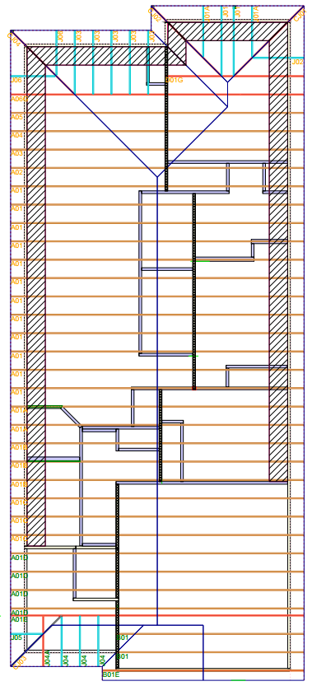
Purpose of TPDs
To assist the builder in positioning or locating the trusses and components supplied by the manufacturer
To serve as detailed installation instructions
To indicate the manufacturer’s assumed location for each truss and component

Slide 7
Background
Although currently the state of Texas has adopted the 2006 IBC, different Jurisdictions have adopted more recent editions.
  For instance, the city of Schertz, Texas has adopted the 2012 IBC through Ordinance No. 15-C-20.
The following information is intended to provide insight into Texas professional engineering law and the building code, and the ramifications of providing seals on TPD for projects governed by the 2012 IRC or 2015 IRC.

Slide 8
Background
The code language regarding Truss Placement Diagrams in the 2012 and 2015 IBC was introduced in the 2006 IBC code change process (S165-04/05).
The proposal was intended to improve clarity in terminology and included only a definition of a TPD:
  2303.4.2 Truss placement diagrams. Diagrams supplied by the truss manufacturer that identify the individually designated truss design drawings do not require the seal of a truss design engineer.

Slide 9
Background
The proposal was modified during the 2006 IBC hearing process as follows:
  2303.4.1.3 Truss Placement Diagram. The truss manufacturer shall provide a truss placement diagram that identifies the proposed location for each individually designated truss and references the corresponding truss design drawing. The truss placement diagram shall be provided as part of the truss submittal package, and with the shipment of trusses delivered to the job site. Truss placement diagrams shall not be required to bear the seal or signature of the truss designer.
  Exception: When the Truss Placement Diagram is prepared under the direct supervision of a registered design professional, it is required to be signed and sealed.

Slide 10
Background
In the 2009 IBC the definition of a TPD was revised again (S217-07/08) as proposed by the National Council of Structural Engineers Associations (NCSEA):
  2303.4.2 Truss placement diagram. The truss manufacturer shall provide a truss placement diagram that identifies the proposed location for each individually designated truss and references the corresponding truss design drawing. The truss placement diagram shall be provided as part of the truss submittal package, and with the shipment of trusses delivered to the job site. Truss placement diagrams that serve only as a guide for installation and do not deviate from the permit submittal drawings shall not be required to bear the seal or signature of the truss designer.

Slide 11
Background
The rationale for the change proposed by S217-07/08 is as follows:
  The truss placement diagram is an erection diagram that replicates the information on the approved construction documents per Section 106.3. As it requires no engineering input, direct supervision and the signature and seal of a registered design professional is not required.

Slide 12
Background
The Commentary to the 2012 IBC Section 2303.4.2 confirms the original intent of the code change.
  This section describes and defines the term "truss placement diagram." It is intended to minimize the confusion that exists in the construction industry between a variety of terms that are often used interchangeably, such as "installation documents," "construction documents," "shop drawings," etc. The term "truss placement diagram" is preferred by the truss industry and is very specific. The section requires a truss placement diagram to identify the location of each truss and references the corresponding truss design drawing to facilitate inspection and proper installation.

Slide 13
Analysis – TX Statutes for Professional Engineering
Requiring the TPD to be sealed, where it is not prepared by an engineer or under his/her immediate personal supervision, is contrary to Texas Engineering Practice Act and Rules which includes language regarding sealing construction documents:
  §137.33 Sealing Procedures (a) The purpose of the engineer’s seal is to assure the user of the engineering product that the work has been performed or directly supervised by the professional engineer named and to delineate the scope of the engineer’s work.
  (b) License holders shall only seal work done by them, performed under their direct supervision as defined in §131.81 of this title, relating to Definitions, or shall be standards or general guideline specifications that they have reviewed and selected. Upon sealing, engineers take full professional responsibility for that work.

Slide 14

Analysis – TX Statutes for Professional Engineering
Based on the above, a TPD does not require a professional engineer’s seal for any building project in the state of Texas.

Slide 15
Analysis – ANSI/TPI 1
In preparing the construction documents, the Building Designer needs to provide the Truss Designer with the information necessary to properly design the trusses for the building .
Both TPI 1-2007, which is referenced by 2012 IBC, and TPI 1-2014, which is referenced by the 2015 IBC, include sections regarding the use of a TPD in Chapter 2.
TPI 1-2014 includes updated language with respect to the individuals performing design work

Slide 16
Analysis – ANSI/TPI 1
The Commentary to TPI 1-2014 Section 2.1 includes the rationale for the change between the two versions:
  “…In an attempt to further clarify the Standard and to remove redundant language, the 2014 edition of the Standard combined Sections 2.3 and 2.4. In doing so, the terms “Registered Design Professional for the Building” and “Truss Design Engineer” were removed and replaced with the more generic terms “Building Designer” and “Truss Designer” respectively. Depending on the job and the statutes of the jurisdiction in which the project is to be constructed, these individuals (or entities) may or may not be required to be Registered Design Professionals. “

Slide 17
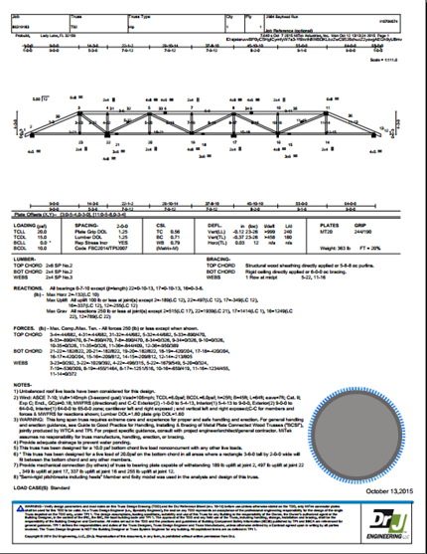
Analysis
The Truss Designer’s sole responsibility is to design the individual trusses according to information provided by the Building Designer
The Truss Designer is therefore specifically responsible for the single truss design depicted on each TDD.

Slide 18
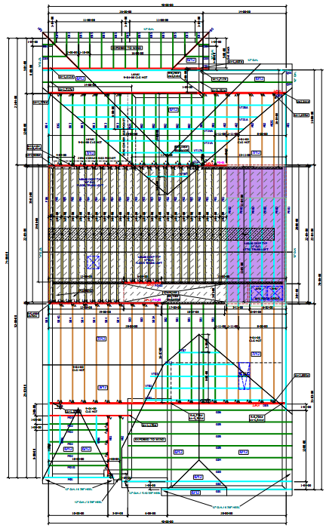
Analysis
TPDs are typically prepared by component manufacturer personnel other than Truss Designers.
The TPDs may not be reviewed or even seen by the Truss Designer.
It is therefore understood that TPDs are not prepared under the Truss Designer’s direct supervision.

Slide 19
Analysis
Because TPD are generally neither created by nor created under the immediate direct supervision of a licensed design professional, they cannot be sealed under Texas Law.
Requesting a Truss Design Engineer to seal a non-registered person’s work is illegal in Texas according to the Texas Engineering Practice Act and Rules which state in pertinent part:

Slide 20
Analysis
§ 1001.401. Use of Seal (a) On receiving a license, a license holder shall obtain a seal in a design authorized by the board, showing the license holder’s name and the legend “Licensed Professional Engineer” or “Registered Professional Engineer.”
RULE §137.33 Sealing Procedures. (a) The purpose of the engineer's seal is to assure the user of the engineering product that the work has been performed or directly supervised by the professional engineer named and to delineate the scope of the engineer's work.
(b) License holders shall only seal work done by them, performed under their direct supervision... Upon sealing, engineers take full professional responsibility for that work. ...

Slide 21
Findings
The 2012 and 2015 IBC Section 2303.4.2 both specify that a TPD does not require the seal of the Truss Design Engineer when the TPD serves only as a guide for installers.
It is the responsibility of the Building Designer to review the TPD, if provided, and verify that it does not deviate from the permit submittal documents.

Slide 22
Conclusion
Truss Design Engineers should NOT be asked by RDPs, Building Designers or Building Code Officials to seal TPDs.

Slide 23
References
ANSI/TPI, National Design Standard for Metal Plate Connected Wood Truss Construction, Truss Plate Institute, 2007
International Building Code, International Code Council, 2006, 2009, 2012, 2015
Texas Engineering Practice Act and Rules Concerning the Practice of Engineering and Professional Engineering Licensure, Texas Board of Professional Engineers, 2015

